Slide 1
Reverse Engineering as Theory Building
Tony Clark t.n.clark@mdx.ac.uk
Balbir Barn b.barn@mdx.ac.uk
School of Engineering and Information Sciences
University Of Middlesex
London, UK

Slide 2
Overview
Motivation:
  Houston, we have a problem.
  Surely this has been done before?
Theory Building:
  An approach: Old wine in new bottles.
  Some technology: New wine in old bottles.
Case Study:
  But what might it look like?

Slide 3
Motivation: There is nothing new under the sun.

Slide 4
The business driver
Software Outsourcing Inc
Issues
High value software maintenance contracts
Outsourcing of source code maintenance of large scale legacy systems
Critical operational systems
Initial contract is limited length – achievement of maintenance requests will lead to longer contract.
Support for responding to rapid ad hoc requests for changes to system
Lack of documentation
Original software developers no longer at the customer company
A common scenario facing many Indian IT providers

Slide 5
Naur’s Theory of Programming
Seminal paper written in 1985
Fundamental assertion:
  Programmers achieve a certain insight or theory of some aspect of the domain that they are addressing
  Based on Ryle (1949) –
    A person who has a theory or facts can do things and explain why and respond to questions
  Explains this in the context of the software lifecycle
Traditionally software methods are focused on artifact production (explicit knowledge). But should be focussed on techne and phronosis (wisdom derived from practice)

Slide 6
Naur’s Thesis: Features
Programming is Theory Building.
Understand the domain as a theory.
Theories consist of information bearing statements about a domain that are true (or false).
No such thing as the ideal theory because:
  many consistent (incomplete) theories.
  theories are personal.
  theories consist of information necessary for stakeholder.

Slide 7
Systems lifecycle and theory building
Theory building
Theory Decay
Analysis and Design
Implementation
Deployed System
Maintenance
Once the system is deployed and enters into a maintenance phase, the only way the theory can be retained is by transfer of knowledge between team members.
The artifacts represent an incomplete documentation of the theory

Slide 8
Naur’s Thesis: Benefit Claims
Core IPR is in theories.
Theories are more abstract than programs.
Maintain system using theories.
Introduce new people using theory not code.
Theories are reusable (code fails to be).
Theories allow questions to be articulated.
Theories capture different views of a system.

Slide 9
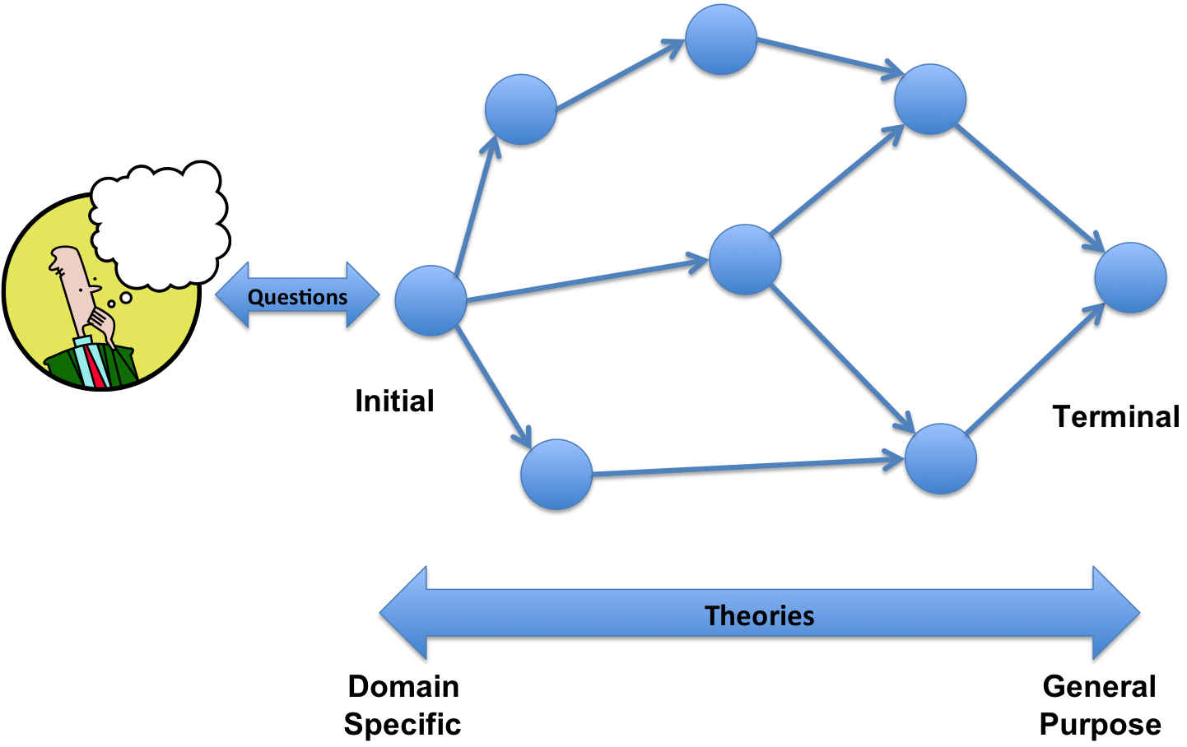
Understanding is Theory Building

Slide 10
What do we currently do?
Program Code:
Just look at the code.
Misunderstandings because:
  the domain is weakly represented in the code.
  unable to articulate questions.
UML Models:
Weakly expressive:
  Static models are OK.
  Dynamic models lack completeness.
Meaning is bound up with translations to code.
Modularity cannot be applied to understanding: have to state the whole thing – no real views.

Slide 11
Naur’s Thesis Applied to Modelling
What’s the difference between modelling and programming?
If programming is the construction of a theory that is then mapped to an implementation (theory) then: Modelling smells like programming to me.
What’s the difference between modelling and domain specific modelling?
A theory building framework gives us a context in which this can be analyzed.

Slide 12
Approach: Building theories about an application.

Slide 13
Theory Building Process
User
Interface
observation
System
Executions
interaction
Source
Code
inspection
Models
(static, dynamic, security, etc.)
formulation
Theorems
(aspects)
modification
Documentation
grounding
comprehension
abstraction
Partial
Theories
Expert
Knowledge
acquisition
slicing
aggregation
Theory

Slide 14
What is a theory?
theorem: true or false statements.
theory: collections of theorems.
axioms: statements that are givens.
rules: ways of constructing theorems.
mappings: between theories (and theorems)
combinations: composing theories (and theorems).
initial: an initial theory maps to all the others.
terminal: every theory maps to a terminal theory.

Slide 15
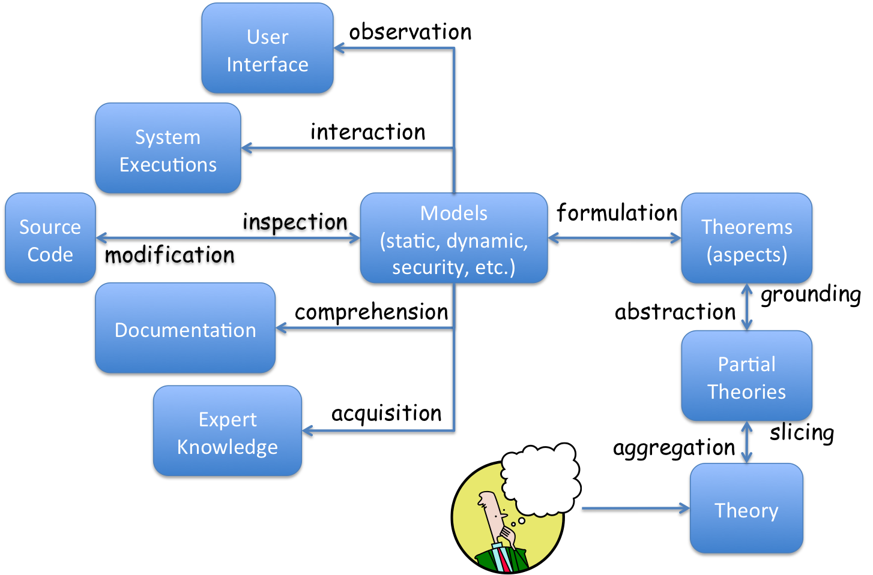
Being Concrete: Aspects of a Simple Case Study

Slide 16
Customer Requirement
Software maintenance contract with a Library.
They have software controlling borrowings at multiple terminals.
Originally sourced from a third party.
They have lost the documentation.
They have the source code.
Occasionally they have noticed books going missing.
Under the contract your company needs to identify and fix the problem.

Slide 17
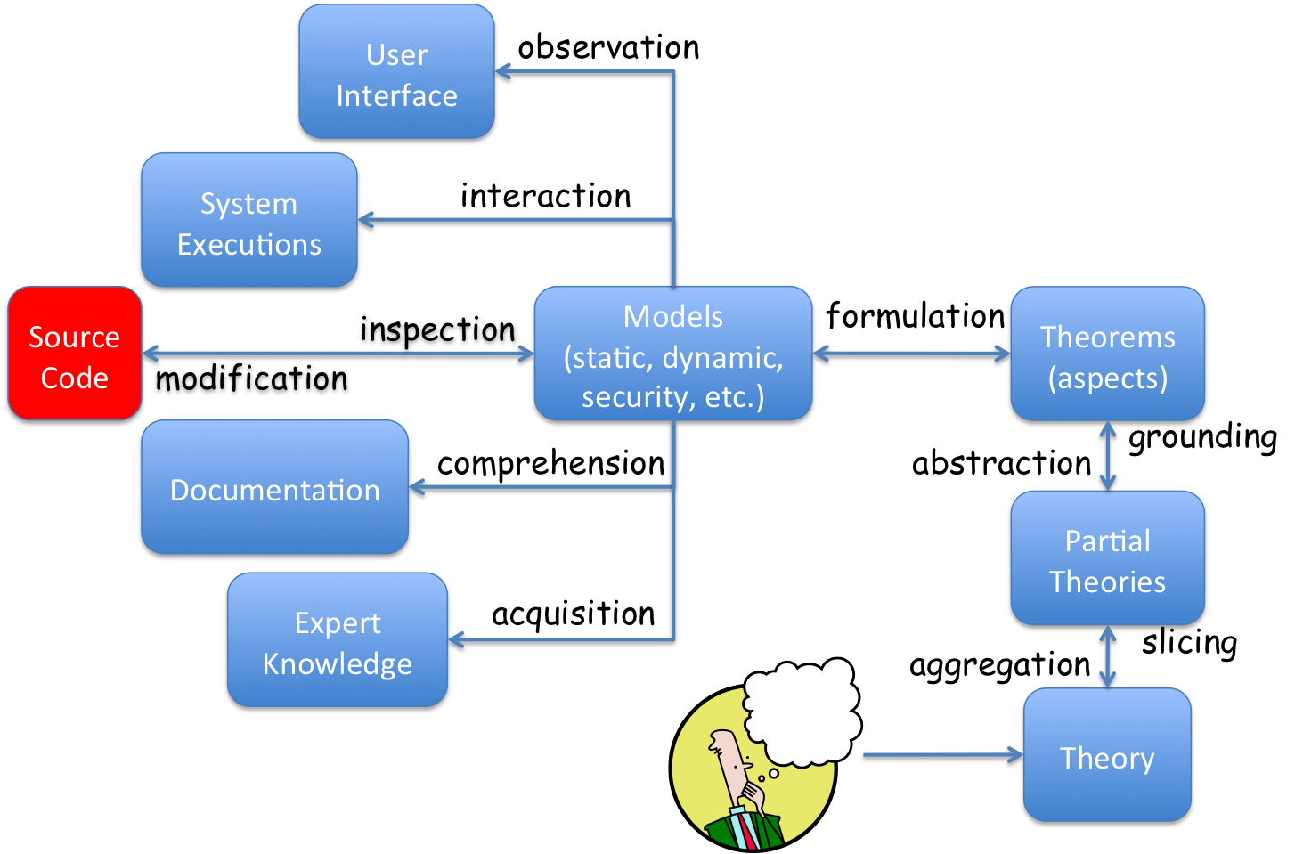
Library Source Code
class Library {
Vector<Reader> readers;
Vector<Book> books;
Hashtable<Reader,Book[]> borrows;
int nextReaderId;
public void handle(Message m) {
switch(m.id) {
case REGISTER:
register(m);
break;
case ADD_BOOK:
add_book(m);
break;
case BORROW:
borrow(m);
break;
...
}
}
...
}
application state
entry point
interface

Slide 18
Library Operations
public void register(Message m) {
String name = (String)m.getData(0);
if(hasReader(name) == false) {
int id = allocateReaderId();
readers.add(new Reader(name,id));
m.reply(id);
} else m.fail();
}
message args
guard
data access
message reply

Slide 19
Borrowing
public void borrow(Message m) {
int id = (int)m.getData(0);
String name = (String)m.getData(1);
Reader reader = getReader(id);
Book book = removeBook(name);
Book[] borrowed = borrows.get(id);
if(borrowed.length < BORROW_LIMIT) {
Book[] updated = new Book[borrowed.length+1];
Array.copyInto(borrowed,updated);
updated[borrowed.length] = book;
borrows.put(reader,updated);
m.reply(OK);
} else m.reply(FAIL);
}
data access
data access

Slide 20
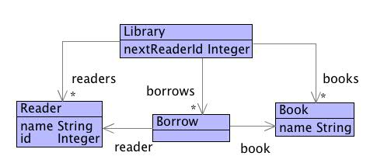
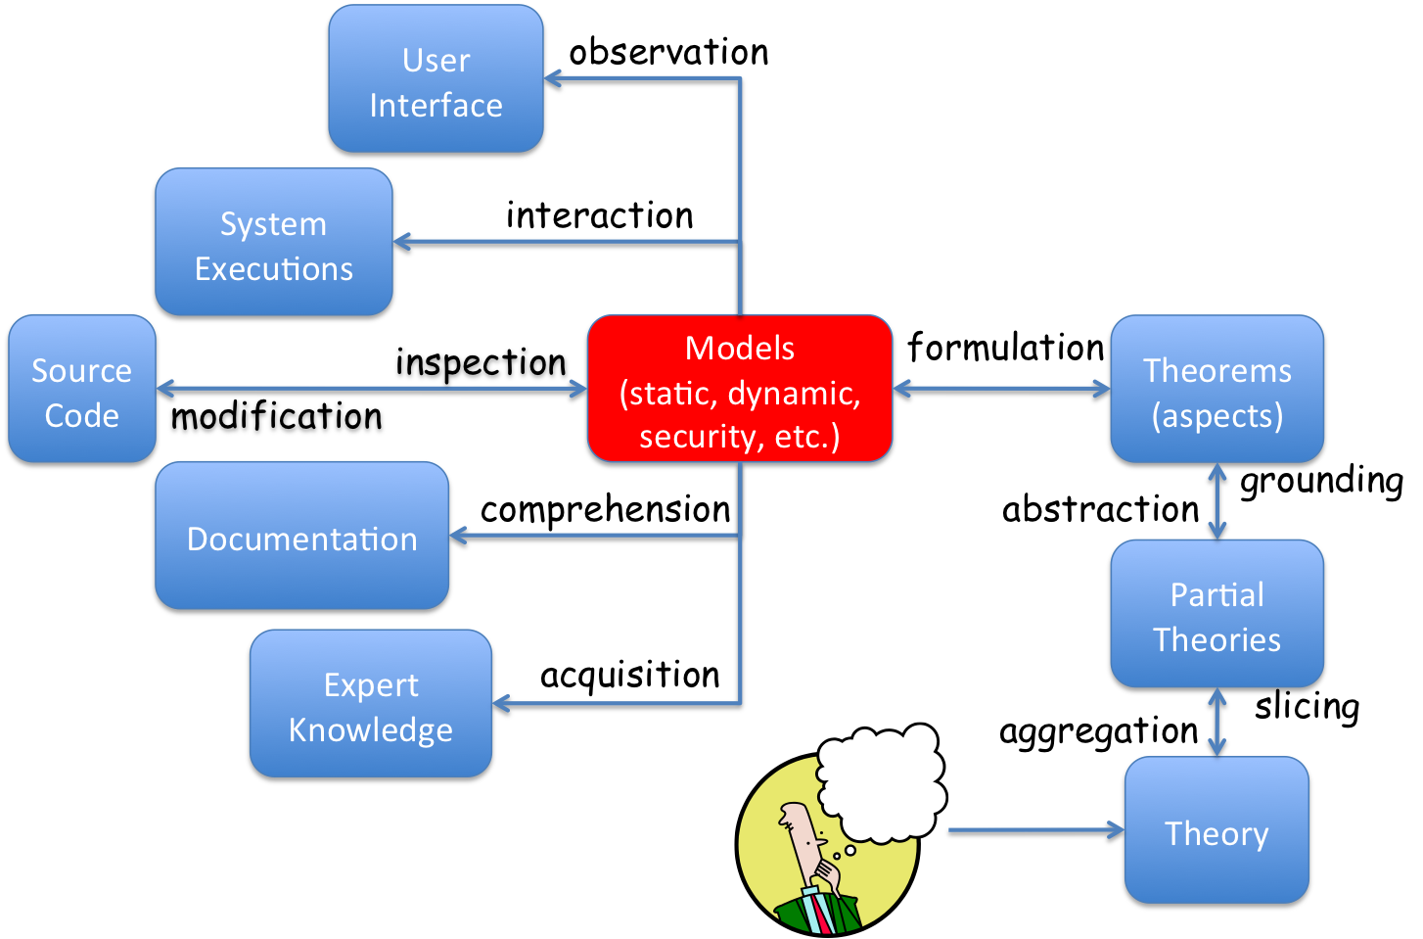
Static Modelling

Slide 21
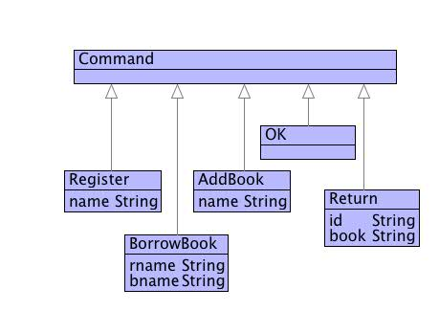
Commands

Slide 22
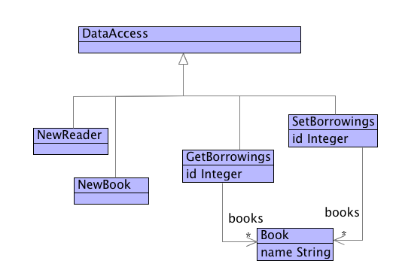
Data Access

Slide 23
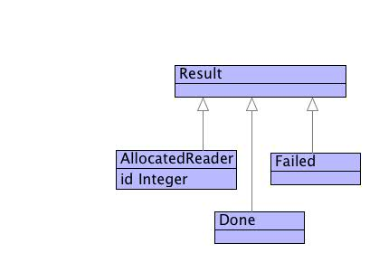
Results

Slide 24
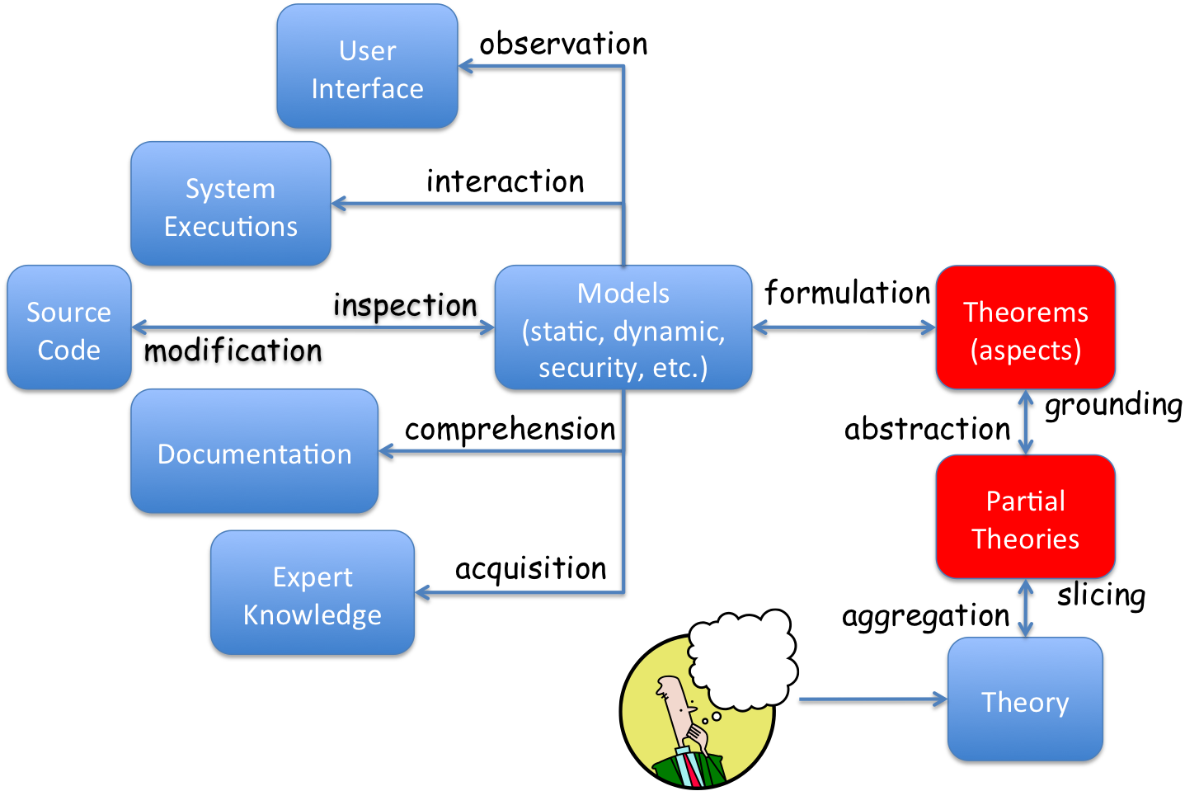
Partial Theories are Defined by Rules
r = (Reader)[name = n; id = i]
not(R->includes(r))
---------------------------------------------- [EvalRule]
(Eval)[
data = (AddReader)[name = n];
result = (ReaderAllocated)[id = i];
change = (StateChange)[
pre = (Library)[
readers = R;
books = B;
borrows = X;
nextReaderId = i];
post = (Library)[
readers = R->including(r);
books = B;
borrows = X;
nextReaderId = i+1
]
]
]

Slide 25
Evaluating More than one Data Access
(Evals)[accesses = Seq{}; changes = Seq{}; results = R] (EvalsRule)
(Eval)[data = a; change = c; result = r]
--------------------------------------------------------- (EvalsRule)
(Evals)[accesses = Seq{a}; changes = Seq{c}; results = Seq{r}]
(Evals)[accesses = P; changes = C; results = V]
(Evals)[accesses = Q; changes = D; results = W]
---------------------------------------------------------- (EvalsRule)
(Evals)[accesses = P + Q; changes = C + D; results = V + W

Slide 26
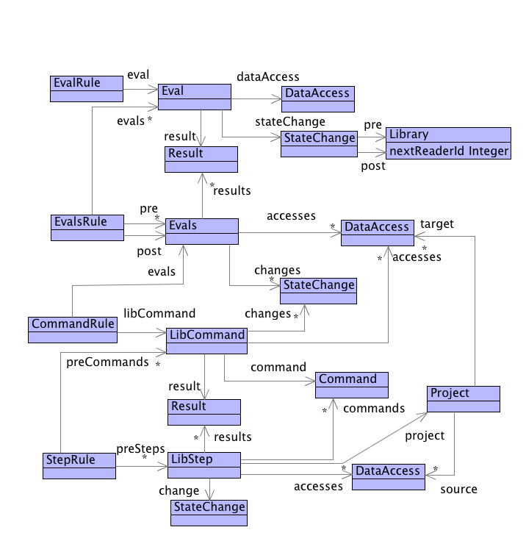
Library
Theory

Slide 27
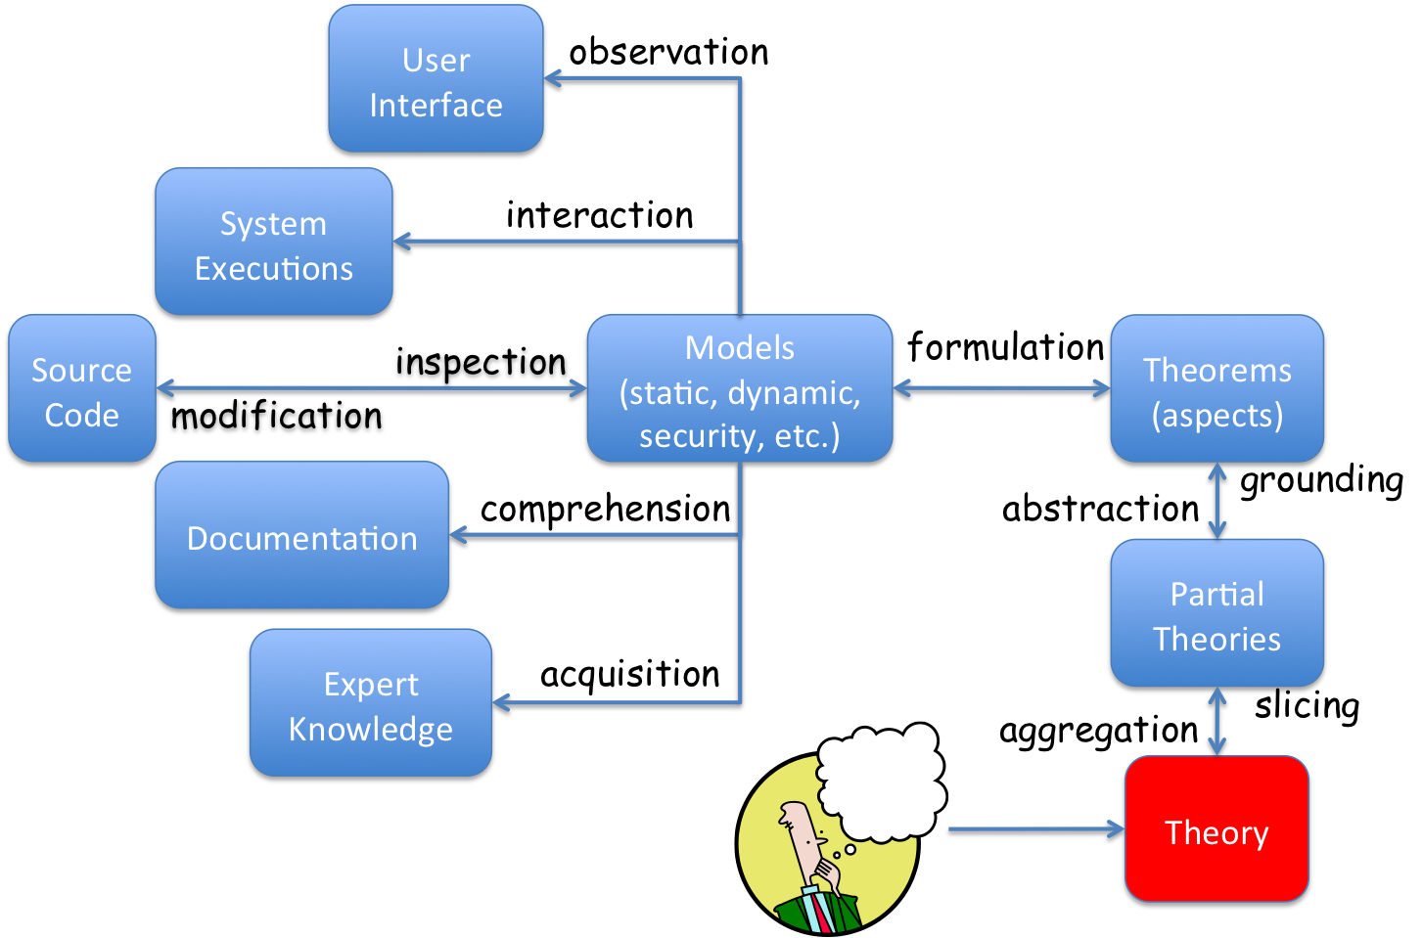
Theorems
Can someone borrow a book without joining the library?
Can two people join the library with the same id?
Is it possible to construct a situation where a book disappears from the library?

Slide 28
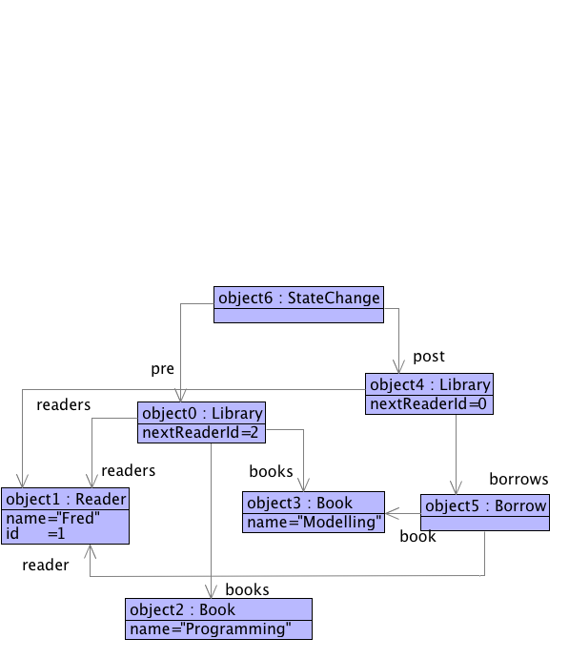
Theorem Development
2

Slide 29
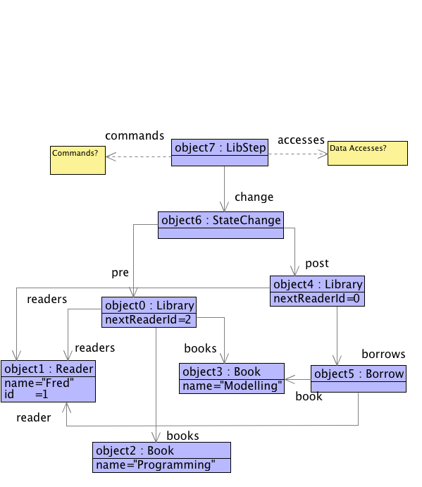
Fill in the Blanks
2

Slide 30
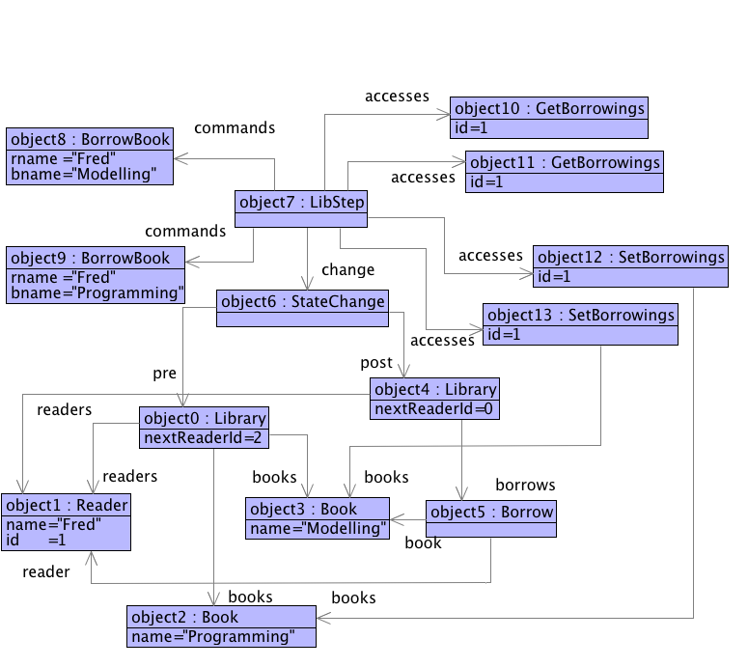
Hypothesize the Blanks
2

Slide 31
Deduction
Deduction: Theory tells us there must be two cards for fred.
Reality: Fred must have duplicated the library card and an accomplice borrows the second book at the same time when fred borrows the first.
Solution: change the theory.

Slide 32
Modify
Definition of
Project

Slide 33
Borrowing (modified)
public synchronized void borrow(Message m) {
int id = (int)m.getData(0);
String name = (String)m.getData(1);
Reader reader = getReader(id);
Book book = removeBook(name);
Book[] borrowed = borrows.get(id);
if(borrowed.length < BORROW_LIMIT) {
Book[] updated = new Book[borrowed.length+1];
Array.copyInto(borrowed,updated);
updated[borrowed.length] = book;
borrows.put(reader,updated);
m.reply(OK);
} else m.reply(FAIL);
}

Slide 34
Conclusion
Understanding is theory building.
Modelling and programming are essentially the same.
Modelling aims to be initial.
Programming needs to be terminal.
Modelling languages should support theories.
Theories need to support:
  translation through mappings.
  different views through combination.
  patterns through parameterization.

