Slide 1
A MOP Based DSL for Testing Java Programs using OCL
Tony Clark
http://itcentre.tvu.ac.uk/~clark/
Centre for Model Driven Software Engineering
School of Computing
Thames Valley University
London, UK

Slide 2
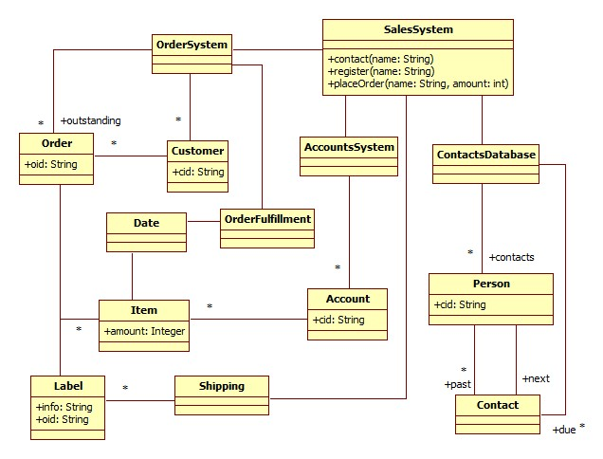
context SalesSystem::placeOrder(name:String,amount:int)
pre: accountsSystem.accounts->exists(a | a.cid = name)
post: accountsSystem.getAccount(name).items->exists(item |
item.amount = amount) and
accountsSystem.getAccount(name).items->size =
self@pre.accountsSystem.getAccount(name).items->size + 1

Slide 3
Aim
To extend XMF with a language feature for testing Java implementations.
To use OCL as the constraint language.
Problem: how to deal with all the possible implementation strategies for the model?

Slide 4
A Little OCL-based Language
@MSpec <name> [<method-name>] (<args>)
pre <pre-condition>
do <body>
post <post-condition>
end
@Test <name>
<spec>*
end

Slide 5
Example Test Scenario
context SalesSystem
@MSpec successfulPlaceOrder[placeOrder](name,amount)
pre accountsSystem.accounts->exists(a | a.cid = name)
do run
post
accountsSystem.getAccount(name).items->exists(item |
item.amount = amount) and
accountsSystem.getAccount(name).items->size =
preSelf.accountsSystem.getAccount(name).items->size + 1
end
@Test Test0
successfulContact("fred")
successfulRegister("fred")
successfulPlaceOrder("fred",100)
end

Slide 6
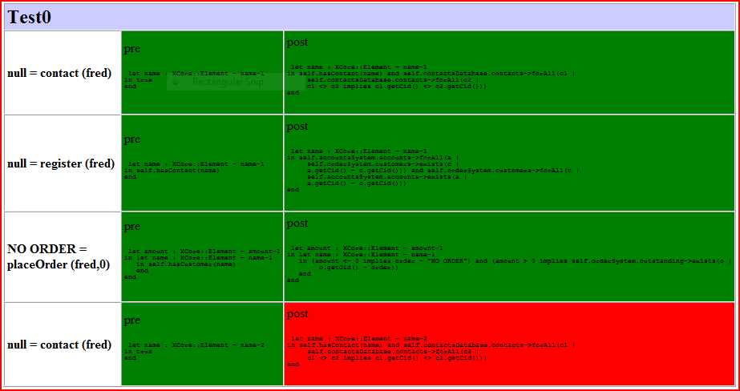
Generate Reports

Slide 7
XMF and OCL
@Class Account
@Attribute cid : String end
@Constructor(cid) end
end
@Class AccountsSystem
@Attribute accounts : Set(Account) (+) end
end
@Class SalesSystem
@Attribute accountsSystem : AccountsSystem = AccountsSystem() end
@Operation addAccount(cid:String)
accountsSystem.addToAccounts(Account(cid)) end
@Operation checkNameExists(name:String):Boolean
accountsSystem.accounts->exists(a | a.cid = name)
end
end

Slide 8
Java Implementation
public class Account {
public String cid;
...
}
public class AccountsSystem {
public Vector<Account> accounts = new Vector<Account>();
...
}
public class SalesSystem {
public AccountsSystem accountsSystem
= new AccountsSystem();
public ContactsDatabase contactsDatabase
= new ContactsDatabase();
public void addAccount(String cid) {
accountsSystem.addToAccounts(new Account(cid));
}
...
}

Slide 9
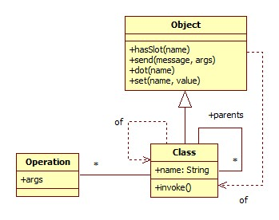
Meta Classes in XMF

Slide 10
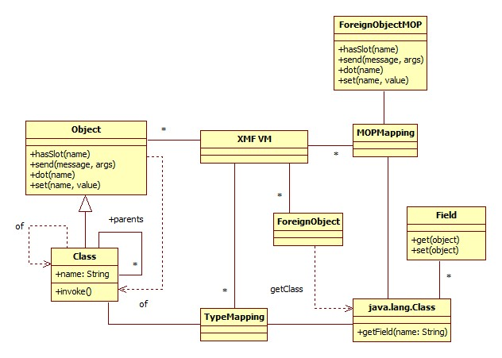
Foreign Objects

Slide 11
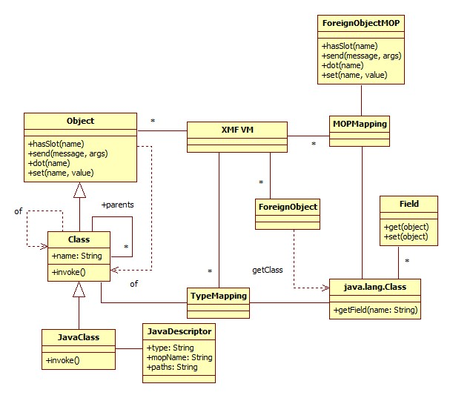
Java Classes in XMF

Slide 12
A Metaclass: JavaClass
@Class JavaClass extends Class
@Attribute descriptor : JavaDescriptor (?,!) end
@Operation addDescriptor(d:JavaDescriptor)
xmf.foreignTypeMapping().put(d.type(),self);
xmf.foreignMOPMapping().put(d.type(),d.mopName());
self.setDescriptor(d)
end
@Operation invoke(target,args)
let class = xmf.javaClass(descriptor.type(),descriptor.paths())
in class.invoke(target,args)
end
end
...
end

Slide 13
A Java MOP
public class ForeignObjectMOP {
public void dot(Machine m, int obj, int name) {
Object o = m.getForeignObject(obj);
Class<?> c = o.getClass();
Field f = c.getField(m.getString(name));
m.pushStack(f.get(o));
}
public void send(Machine m, int o, int m, int args) {
// Send message and push return value...
}
public boolean hasSlot(Machine m, int o, int name) {
// Return true when object has named slot
}
public void set(Machine m, int o, int name, int value) {
// Set named slot...
}
}

Slide 14
XMF access to Java
@Class Account metaclass JavaClass
JavaDescriptor("Account","",Seq{"@/bin"})
end
@Class AccountsSystem metaclass JavaClass
JavaDescriptor("AccountsSystem","",Seq{"@/bin"})
end
@Class SalesSystem metaclass JavaClass
JavaDescriptor("SalesSystem","",Seq{"@/bin"})
@Operation checkNameExists(name:String):Boolean
accountsSystem.accounts->exists(a | a.cid = name)
end
end

Slide 15
Making the Default MOP Explicit
@Class Account metaclass JavaClass
JavaDescriptor("Account",“foreignobj.ForeignObjectMOP",Seq{"@/bin"})
end
context Root
@Class AccountsSystem metaclass JavaClass
JavaDescriptor("AccountsSystem",“foreignobj.ForeignObjectMOP",Seq{"@/bin"})
end
context Root
@Class SalesSystem metaclass JavaClass
JavaDescriptor("SalesSystem","foreignobj.ForeignObjectMOP",Seq{"@/bin"})
@Operation checkNameExists(name:String):Boolean
accountsSystem.accounts->exists(a | a.cid = name)
end
end

Slide 16
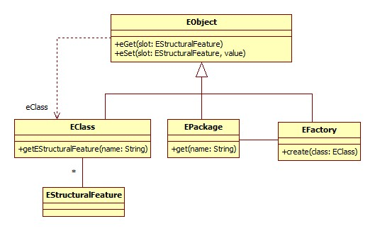
A Different Implementation: EMF

Slide 17
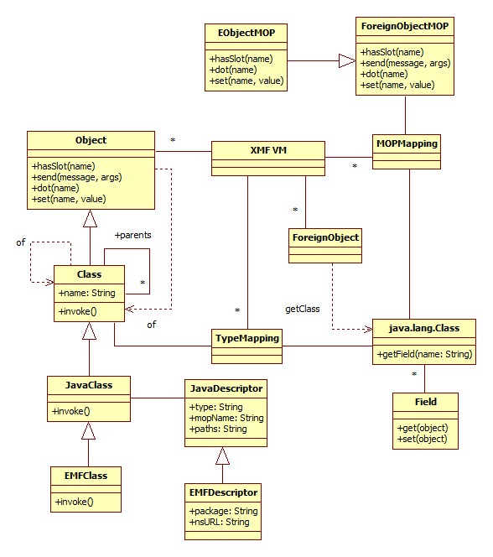
An EMF MOP

Slide 18
A Metaclass: EMFClass
@Class EMFClass extends JavaClass @Operation invoke(target,args) let factory = descriptor.getFactory() then package = descriptor.getPackage() then class = package.send("get" + name,Seq{}) then object = factory.create(class)
in // Set fields from args using constructor...
object
end
end
...
end

Slide 19
EMFMop
public class EObjectMOP extends foreignobj.ForeignObjectMOP {
public void dot(Machine machine, int object, int name) {
EObject eobject = (Eobject)machine.getForeignObject(object);
EClass eclass = eobject.eClass();
String string = machine.getString(name);
EStructuralFeature feature = eclass.getEStructuralFeature(string);
machine.pushStack(eobject.eGet(feature));
}
public boolean hasSlot(Machine machine, int obj, int name) {
...
}
public void set(Machine machine, int obj, int name, int value) {
...
}
}

Slide 20
XMF access to EMF
@Class Account metaclass EMFClass
EMFDescriptor("sales.impl.AccountImpl","sales","sales","test.EObjectMOP")
@Constructor(cid) end
end
@Class AccountsSystem metaclass EMFClass
EMFDescriptor("sales.impl.AccountsSystemImpl","sales","sales","test.EObjectMOP")
end
@Class SalesSystem metaclass EMFClass
EMFDescriptor("sales.impl.SalesSystemImpl","sales","sales","test.EObjectMOP")
@Operation init()
self.accountsSystem := AccountsSystem()
end
@Operation addAccount(cid:String)
accountsSystem.getAccounts().add(Account(cid))
end
@Operation checkNameExists(name:String):Boolean
accountsSystem.accounts->exists(a | a.cid = name)
end
end

Slide 21
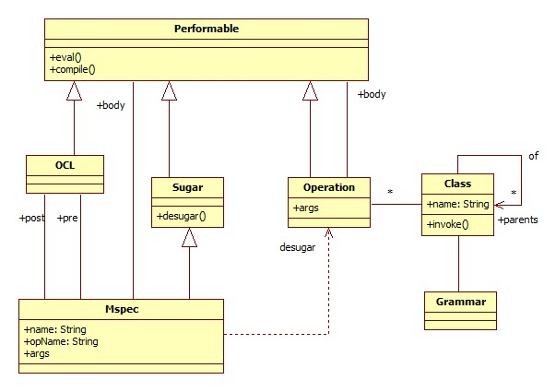
Implementing the DSL

Slide 22
Example
@MSpec successfulPlaceOrder[placeOrder](name,amount)
pre accountsSystem.accounts->exists(a | a.cid = name)
do run
post accountsSystem.getAccount(name).items->exists(...) and ...
end
@Operation successfulPlaceOrder (.args)
let name = args->at(0)
amount = args->at(1)
in let preSelf = self.deepCopy()
in if accountsSystem.accounts->exists(a | a.cid = name)
then let result = self.send(“placeOrder”,Seq{name,amount})
in if accountsSystem.getAccount(name).items->exists(...) and ...
then CallSucceeds(result,”placeOrder”,args)
else PostFails(“placeOrder”,args)
end
end
else PreFails(“placeOrder”,args)
end
end
end
end

