Slide 1
Mining Course Management System (MCMS) and Intelligent Decision Support Special Interest Group (IDS-SIG)
Tony Clark
Centre for Model Driven Software Engineering
School of Computing
Thames Valley University

Slide 2
Project Aims
MCMS is a JISC funded project that aims to:
Detect patterns in institutional data that indicate issues leading to student retention problems
Develop an approach to real-time student support and intervention that addresses retention issues.
Provides high-quality information in support of institution decision making processes.

Slide 3
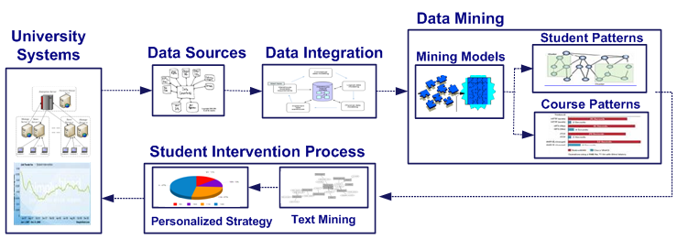
The MCMS Process
Collecting Data Sources
Data Integration
Data Mining
Student Intervention

Slide 4
Data Mining can Answer Questions and Test Hypotheses
Is the student performance, such as average mark, drop out, pass/fail related to student background profile?
Student performance is not related to:
Gender
Race
Age
Disability
Nationality.
Student performance is related to:
Year of study
VLE usage
Library Usage

Slide 5
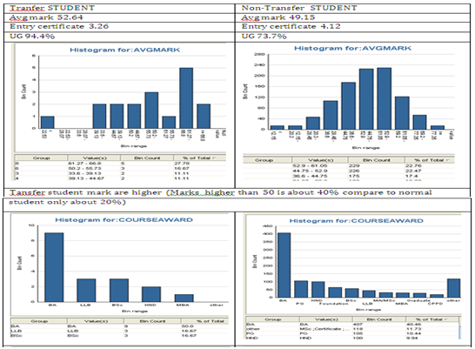
What is the profile of students of students that transfer courses after year 1 and those that transfer after year 2?
They are mostly UG student, enroll with lower certificate, but get higher marks.

Slide 6
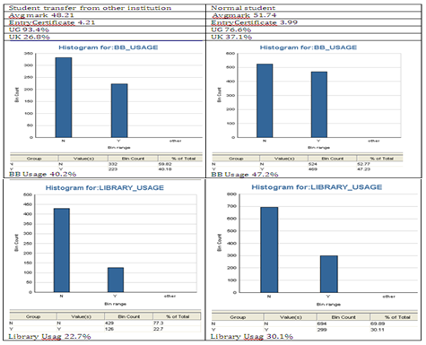
What are the characteristics of students transferring from other institutions?
Student transfer from other institutions are mainly UG student, enroll with higher certificate, use library & BB less, and get lower marks and are mainly overseas.

Slide 7
Intervention
1. Intervention process (email, SMS, ...)
2. Motivate student
iMCMS System
Student
3. Report risky students
4.Module data
5. Give feedback
Module Tutor/staff

Slide 8
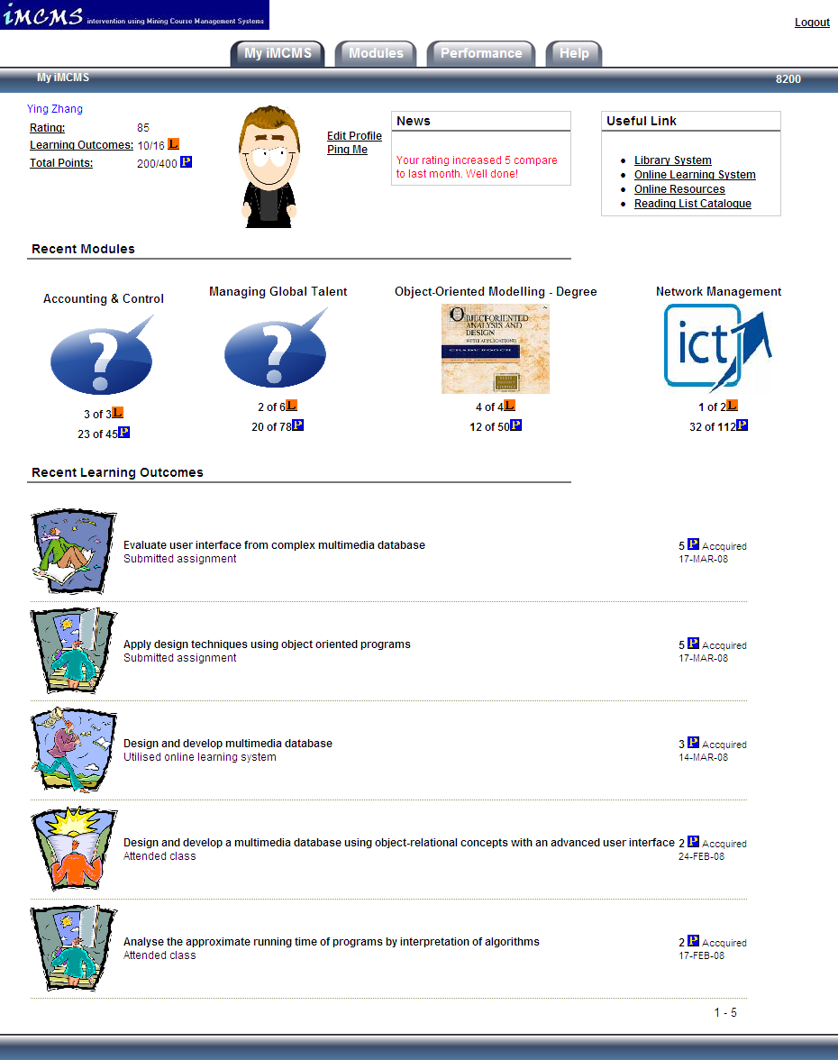

Slide 9
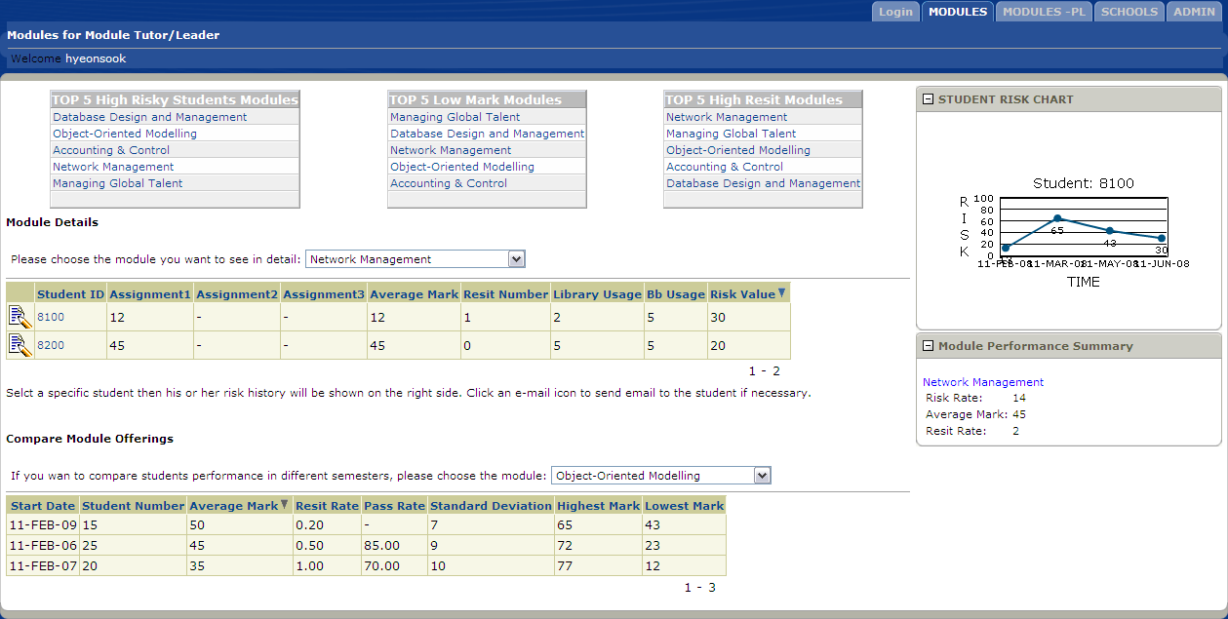
Module Tutor Page

Slide 10
Intelligent Decision Support in HE
Issues:
Management and Strategic requirements for decision support.
Available technologies and gap analysis.
Multiple Data Sources:
Data Integration
Data Cleansing
Reusable processes
Engagement and motivation:
Students
Staff
Institution processes and committees
Supplier engagement

Slide 11
Intelligent Decision Support SIG
Planning a submission to become an STG Pathfinder member.
Aims:
Address issues above.
Engage with key institutional stakeholders.
Identify sector-side requirements and develop IDS roadmap.
Identify scope for sector-wide reusable solutions (shared service?)
Identify synergy with other activities.
Contact tony.clark@tvu.ac.uk with expressions of interest in SIG.

