Slide 1
LEAP: A Precise Lightweight Framework for Enterprise Architecture
Tony Clark t.n.clark@mdx.ac.uk
Balbir Barn b.barn@mdx.ac.uk
School of Engineering and Information Sciences
Middlesex University, London, UK
Samia Oussena samia.oussena@tvu.ac.uk
Thames Valley University, London, UK

Slide 2
Overview
Enterprise Architecture (EA)
What is EA for?
Technologies for EA
Problems and Proposal
Language Driven Modelling
LEAP: A Language for EA
A Simple Case Study
Future Work

Slide 3
Enterprise Architecture
Enterprise Architecture (EA) aims to capture the essentials of a business, its IT and its evolution, and to support analysis of this information: the what, why and how of a business.
EA uses: business change management; quality measurement; acquisition and mergers; compliance.
Focus: strategic alignment and business change management.

Slide 4
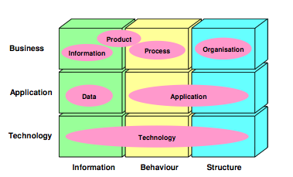
EA: Modelling Technologies
TOGAF; MODAF; BMM; UML profiles.
Focus: ArchiMate 3-layer modelling:
Wilco Engelsman, Dick Quartela, Henk Jonkers, and Marten van Sinderen. Extending enterprise architecture modelling with business goals and requirements, 2010

Slide 5
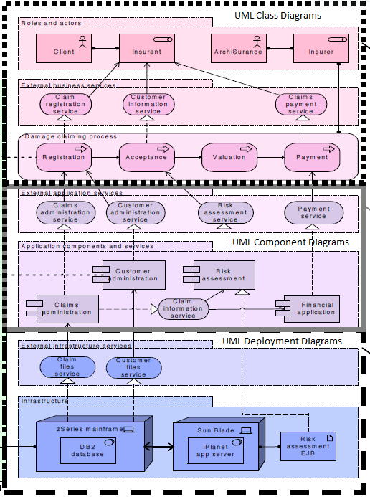
ArchiMate Concepts
Maria-Eugenia Iacob, Henk Jonkers, and Martijn Wiering. Towards a uml proﬁle for the archimate language, 2004.

Slide 6
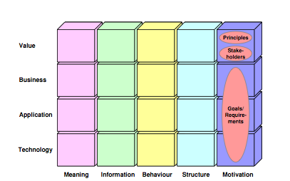
EA: Business Motivation
ArchiMate with extension for motivation:
Wilco Engelsman, Dick Quartela, Henk Jonkers, and Marten van Sinderen. Extending enterprise architecture modelling with business goals and requirements, 2010

Slide 7
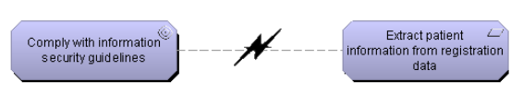
Extension is Weakly Defined
Business goals are free-format text.
Claim: conflict detection:
Wilco Engelsman, Dick Quartela, Henk Jonkers, and Marten van Sinderen. Extending enterprise architecture modelling with business goals and requirements, 2010

Slide 8
Problems and Contribution
Problems with ArchiMate:
Overlapping Concepts
Lack of precision (no semantics).
No complex events (part of future work).
Weak relationships between layers.
Problems with proposed extension for business motivation:
Free format text (cf BMM) how can consistency be assured?
Contribution:
A language driven approach to EA technology that achieves:
Orthogonal concepts.
Semantics.
Strong refinement relationships.
Use of OCL for business motivation:
Precision.
Can establish consistency.

Slide 9
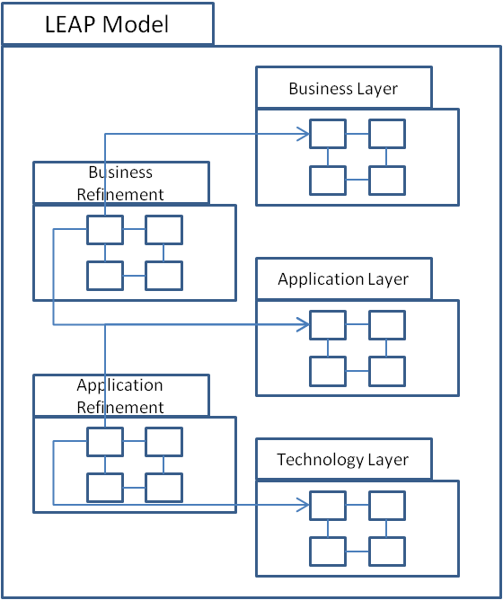
LEAP: Layers

Slide 10
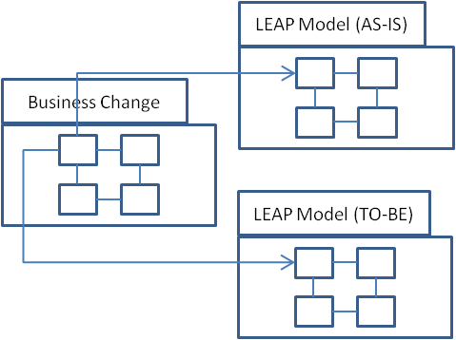
LEAP: Business Change

Slide 11
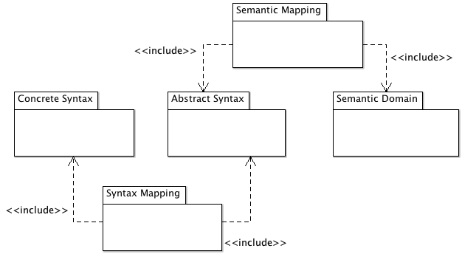
Language Driven Modelling

Slide 12
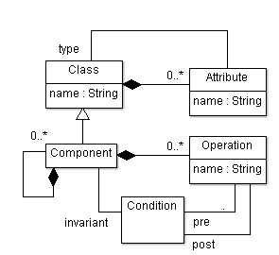
LEAP Abstract Syntax: Layers

Slide 13
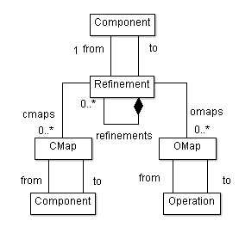
LEAP Abstract Syntax: Refinement

Slide 14
LEAP Semantics: Refinement
context Refinement inv:
from.components = cmaps.from and
from.components.operations = omaps.operations and
refinements.from = from.components
refine<layer>(<high-level>,<lower-level>) components:
<cmap constraints>
refine <layer>(<high-level>,<lower-level>) operations:
<omap constraints>

Slide 15
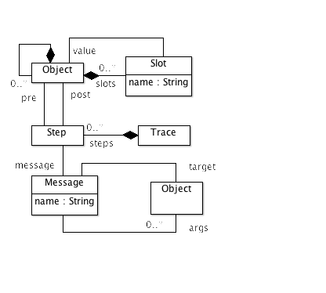
LEAP Semantics: Layers

Slide 16
Case Study
A University decides to implement a lap-top loan scheme to become more attractive to prospective students.
Questions:
Are rooms fit for purpose?
How many lap-tops should there be?
What new IT systems are required.
Do existing IT systems need to be modified?
What business processes are required?
Can all business goals be satisfied?

Slide 17
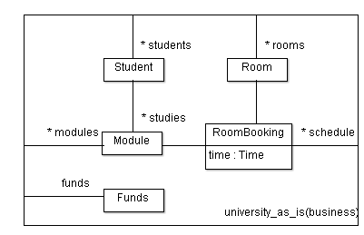
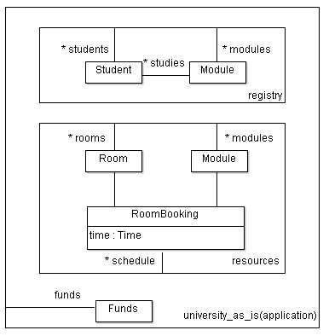
As-Is
Business
refine
Application

Slide 18
As-Is Goals
context university_as_is(business) inv:
students.studies->subset(modules) and
schedule->foraAll(s |
rooms->includes(s.room) and
modules->includes(s.module))

Slide 19
As-Is Operations
context university_as_is(business)::register(s:Student,m:Module)
post: students->includes(s) and
modules->includes(m) and
student.modules->includes(m)

Slide 20
As-Is(Application) Operations
context university_as_is(application)
::registerStudent(s:Student)=
registry.registerStudent(s)
::registerModule(m:Module)=
registry.registerModule(m)
::allocateStudent(s:Student,m:Module)=
registry.allocateStudent(s,m)
context university_as_is(application)::registry
::registerStudent(s:Student))
post: students->includes(s)
::registerModule(m:Module)
post: modules->includes(m)
::allocateStudent(s:Student,m:Module)
post: s.modules->includes(m)

Slide 21
Refinement Constraint(1)
refine university_as_is(business,application) components:
from.students = to.registry.students and
from.modules = to.registry.modules and
from.rooms = to.resources.rooms and
from.modules = to.resources.modules and
from.schedule = to.resources.schedule and
from.funds = to.funds

Slide 22
Refinement Constraint(2)
refine university_as_is(business,application) operations:
from.register(s,m) =
to.registerStudent(s);
to.registerModule(m);
to.allocateStudent(s,m)

Slide 23
Verification
Use of OCL and a language driven modelling approach to LEAP allows precise verification of the claim for refinement:
All correct (as-is or to-be) application-layer traces map onto correct business-layer traces.
All business-layer traces are covered by the application layer.

Slide 24
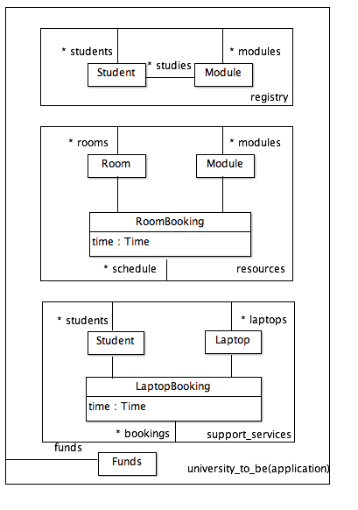
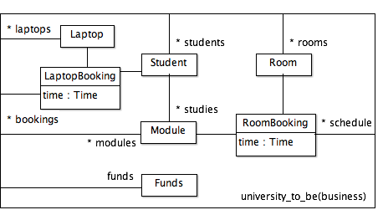
To-Be
Business
refine
Application

Slide 25
Business Change as Pre- and Post-Conditions
The As-Is model constitutes a pre-condition.
The To-Be model and the mapping between the As-Is and the To-Be constitute a post-condition.
The traces semantics and use of OCL allow the business change to be validated under different scenarios.

Slide 26
LEAP: Precise Business Goals
context university_to_be(business) inv:
funds > 0 and
laptops->size = maxStudents()->size
context university_to_be(business) inv:
funds =
students->size * tuition_fees -
laptops->size * laptop_cost
Do any semantic traces lead to a violation?
If so goals are inconsistent.

Slide 27
Conclusion and Further Work
LEAP:
Language Driven Approach to EA.
Simple, orthogonal concepts.
Refinement between layers.
Semantics + OCL supports precise analysis.
Next Steps:
Goal Modelling (BMM)
Complex Events.
Business Processes.
Larger case studies.

