Slide 1
The Knowledge Industry Survival Strategy (KISS)
Tony Clark, Thames Valley University, London, UK
Jorn Bettin, Sofismo, Switzerland

Slide 2
DSLs: Benefits and Problems
Benefits:
express problems in a compact form that reflects the natural terminology of human domain experts
Raise the level of abstraction
Clean separation of concerns in problem space.
Problems:
Interoperability (similar to CASE tools in 90s)
Cannot realise tool chains.
No common framework, processes, terminology,...

Slide 3
Tool Chain Scenario
Given:
A tool to support business motivation (goal) modelling.
A tool to design business components (information models + state machines)
A tool to design business processes (generate enterprise workflow applications)
How would these work together to produce a complete application?

Slide 4
Tool Chain Requirements
Tools should be able to persist models.
A tool must be able to supply its models to another tool.
A tool must make its data format available
Inter-tool control
Precise model semantics

Slide 5
Tool Definitions and Terms
Model
Abstract Syntax
Concrete Syntax
Well-formedness
Language Definition
Semantics
Meta-language
Generic Tool
Model Transformation
Model Persistence
Model Weaving
Model Execution
Model Editor
Model Reader
Model Writer
Model Walker
Tool Interface
Tool Chain
Tool Framework

Slide 6
Current Approaches
Standard-like technologies and OS :
UML
MOF
EMF, GMF, Xtext, oAW,...
Vendor-specific technologies:
MS Visual Studio, Oslo
MetaCase, ...
MPS, Intensional, ...
Research Technologies:
Stratego, ...

Slide 7
KISS: Aims and Core Values
Automate software construction from domain models.
Work with domain specific assets
Support the emergence of supply chains.
Open Source Infrastructure
Support the Agile Manifesto
Language Definition covers all Use Cases.

Slide 8
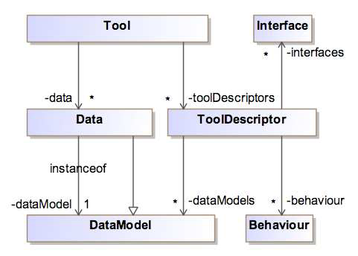
Interoperability: Tool Descriptors

Slide 9
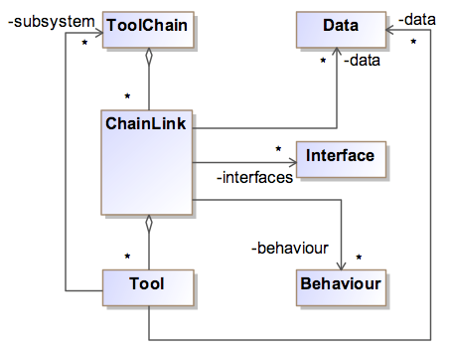
Interoperability: Tool Chains

Slide 10
Interoperability: DSML Tools

Slide 11
Interoperability: Syntax

Slide 12
Interoperability: Syntax

Slide 13
Interoperability: Tool Interfaces

Slide 14
Interoperability: Behaviour

Slide 15
Interoperability: Meta-Models

Slide 16
Compliance Levels
0. No specific features are identifiable.
1. DSL tools interoperate through reified interfaces, e.g. persistence.
2. Tools interoperate through a common serialization format (shared meta-language through translation).
3. Dynamically shared data (shared meta-language).
4. Common language/model manipulation through common service (limited shared behaviour).
5. Interoperable behaviour through common behaviour representation.

Slide 17
Interoperability Compliance Levels

