Slide 1
Domain Specific Modelling as Theory Building
Tony Clark t.n.clark@mdx.ac.uk
Balbir Barn b.barn@mdx.ac.uk
School of Engineering and Information Systems
University Of Middlesex
London, UK

Slide 2
Overview
Motivation
Peter Naur: Programming as Theory Building
Current State of Technologies
A Language for Model Based Theory Building
Examples

Slide 3
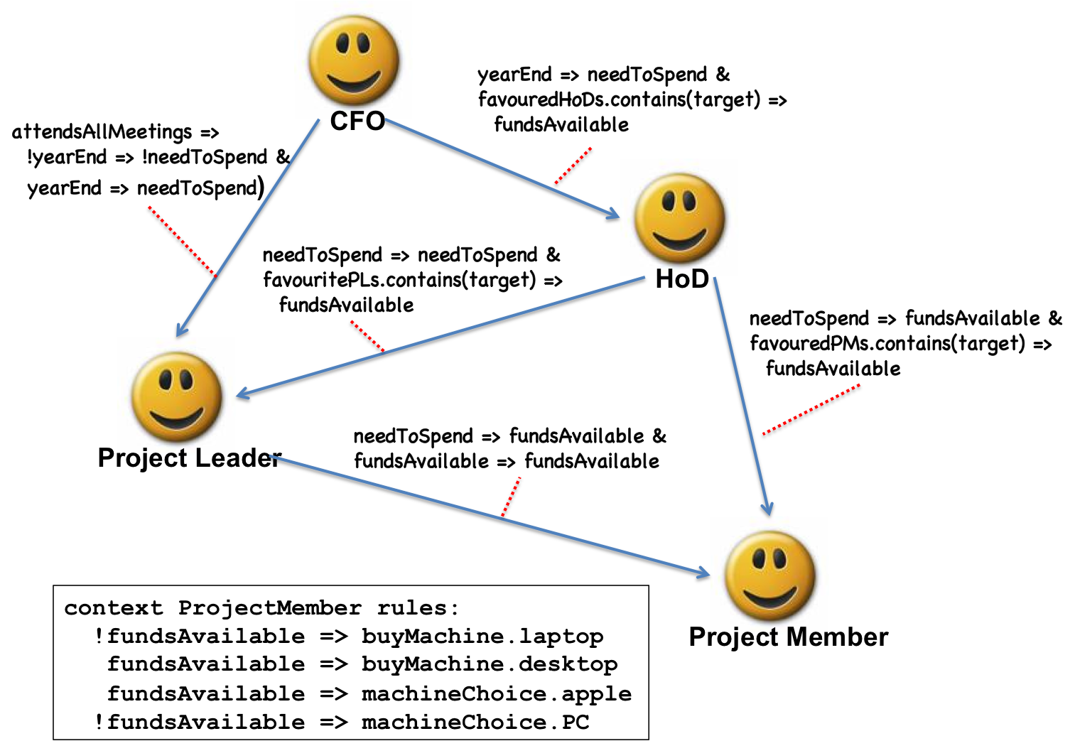
How do we understand a domain?

Slide 4
Naur’s Thesis: Features
Programming is Theory Building.
Understand the domain as a theory.
Theories consist of information bearing statements about a domain that are true (or false).
No such thing as the ideal theory because:
many consistent (incomplete) theories.
theories are personal.
theories consist of information necessary for stakeholder.

Slide 5
Naur’s Thesis: Benefit Claims
Core IPR is in theories.
Theories are more abstract than programs.
Maintain system using theories.
Introduce new people using theory not code.
Theories are reusable (code fails to be).
Theories allow questions to be articulated.
Theories capture different views of a system.

Slide 6
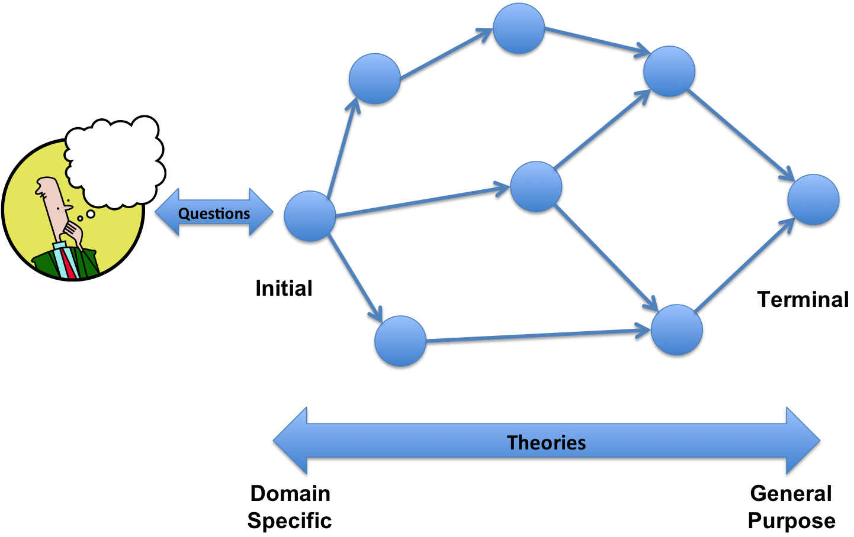
Understanding is Theory Building

Slide 7
What do we currently do?
Just look at the code.
Misunderstandings because:
the domain is weakly represented in the modelling language.
unable to articulate questions.
(Tools for) DSLs are syntax-bound and semantics-free.
Meaning is bound up with translations to code.
Modularity cannot be applied to understanding: have to state the whole thing – no real views.

Slide 8
Naur’s Thesis Applied to DSM
What’s the difference between modelling and programming?
If programming is the construction of a theory that is then mapped to an implementation (theory) then: Modelling smells like programming to me.
What’s the difference between modelling and domain specific modelling?
A theory building framework gives us a context in which this can be analyzed.

Slide 9
What is a theory?
theorem: true or false statements.
theory: collections of theorems.
axioms: statements that are givens.
rules: ways of constructing theorems.
mappings: between theories (and theorems)
combinations: composing theories (and theorems).
initial: an initial theory maps to all the others.
terminal: every theory maps to a terminal theory.

Slide 10
What is a Domain Specific Theory?
Suppose our questioner wants to understand when it follows that an influencing agent has an effect on an influenced agent.
Questions might include:
do the two agents have to be linked?
does it depend on the states of the agents?
if the influencer state satisfies the pre, must the influenced state satisfy the post?
A theory is built by continued diligent questioning of the domain (expert or empirically).

Slide 11
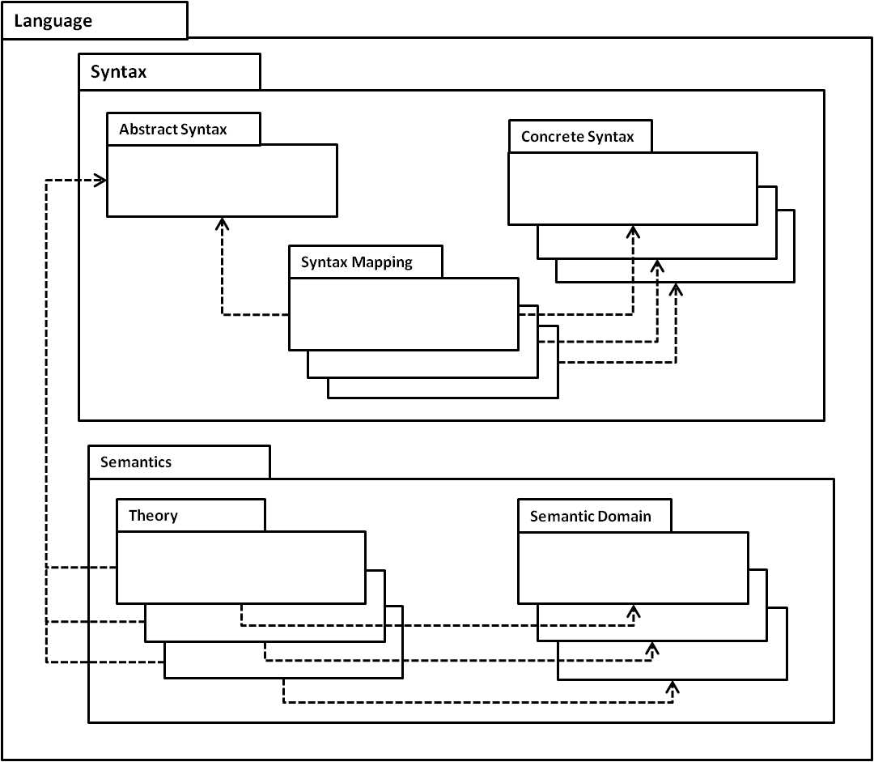
Modelling Languages

Slide 12
Modelling Theories
Traditional natural semantics-style deduction rules have their modelling counterpart.
:x
:y
:z
:T
:D
:Rule
:Theory
:T
T(x,y,z)
:a
:x
:c
D
T(a,x,c)

Slide 13
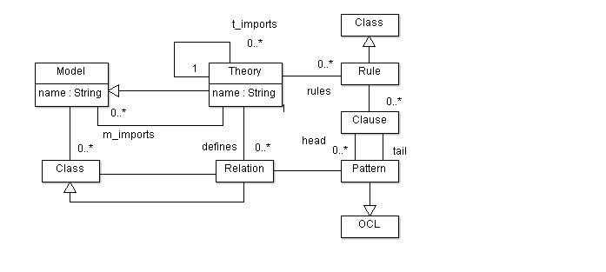
Abstract Syntax for Theories

Slide 14
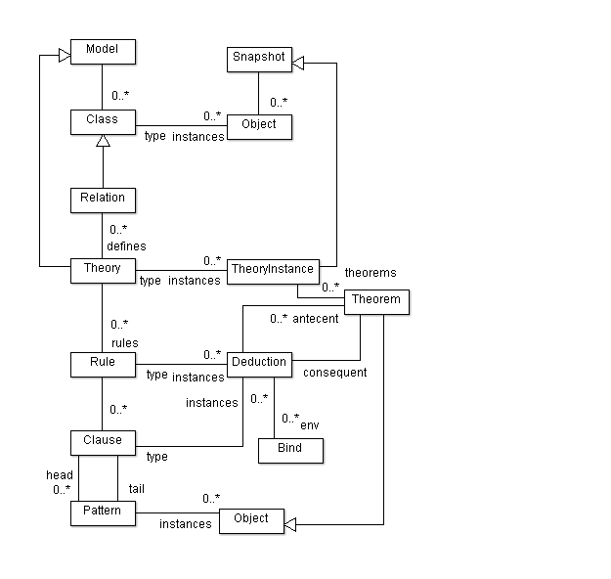
Theory Semantics

Slide 15
Concrete Syntax for Model Based Theories
Use enhanced object diagrams.
Use a textual syntax consisting of class-models and rules.

Slide 16
The Domain (Again)

Slide 17
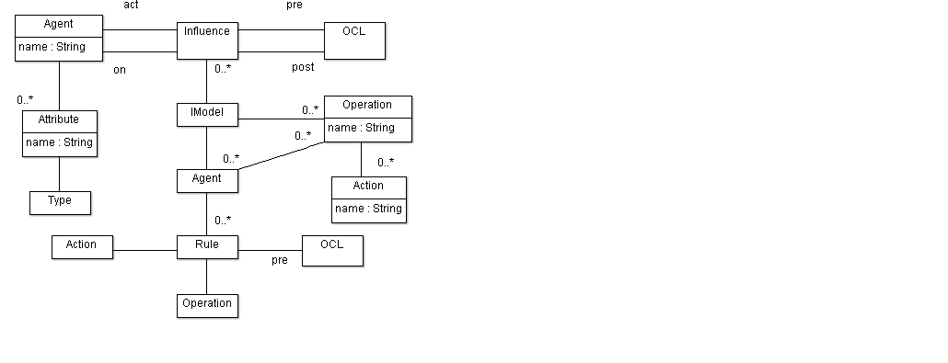
Abstract Syntax for DSM

Slide 18
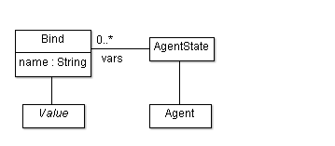
Semantic Domain

Slide 19
Domain Question
Given any collection of agents in any states and given influencing relationships between the agents – are the relationships satisfied or not?

Slide 20
Defining the Influencer Theory
context influence_language::semantics
theory influence {
import OCL;
import influence_language::syntax::AS;
import influence_language::semantics::SD;
relation I {
influences:Set(Influence);
state:Set(AgentState)
}
rule IR(Seq(evalOCL),Seq(I))<->I {
}
}

Slide 21
Defining an Axiom
context influence_language
::semantics::influence::IR
clause {
-> (I)[influences=Set{};state=S]
}

Slide 22
Defining a Rule
context influence_language::semantics::influence::IR
clause {
(evalOCL)[
exp=p1; target=a1;
env=b1->including((Bind)[name='target';value=a2])]
(evalOCL)[
exp=p2; target=a2;
env=b2->including((Bind)[name='source';value=a1])]
->
(I)[influences=Set{
(Influence)[from=a1;to=a2;pre=p1;post=p2]};
state={(AgentState)[agent=a1;vars=b1],
(AgentState)[agent=a2;vars=b2]
}->including(S)]
}

Slide 23
Defining Induction
context influence_language
::semantics::influence::IR
clause {
(I)[influences=P;state=S]
(I)[influences=Q;state=S]
->
(I)[influences=P->union(Q);state=S]
}

Slide 24
Implementation Language: Concrete Syntax
XModel ::= Fun* // programs
Fun ::= Name '(' Args ')' '{' Exp '}' // function definitions
Args ::= Name (',' Name)* | Empty // argument lists
Exp ::= Exp '.' Name // field reference
| OCL // OCL expressions
| 'case' Name Name '{' Arm* '}' // case analysis
| 'let' Bind* 'in' Exp // local bindings
| Name '(' Args ')' // function call
| Name // var reference
Arm ::= String String '->' Exp // string detection
Bind ::= Name '=' Exp // local binding

Slide 25
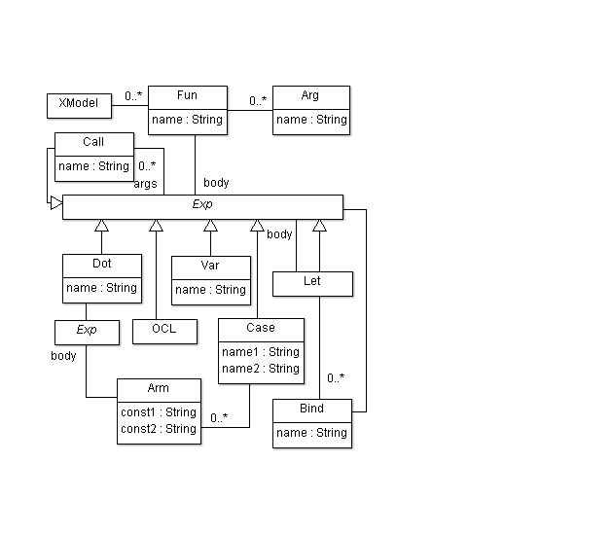
Implementation Language

Slide 26
Implementation Theory
context XL::semantics
theory run {
import OCL;
import XL::syntax::CS;
import XL::semantics::SD;
relation R {
prog:XModel;
exp:Exp;
val:Value;
env:Set(Bind)
}
relation RS {
prog:XModel;
exps:List(Exp);
vals:List(Value);
env:Set(Bind)
}
}

Slide 27
Mapping to An Implementation
The domain theory can answer many questions.
When mapping to an implementation it is usual to focus on one question.
Select: given states for all agents, an operation and an action, can the agent use the action to perform the operation?

Slide 28
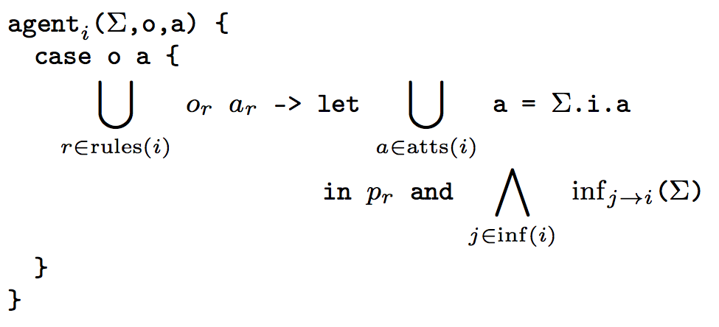
Mapping to Code(1)

Slide 29
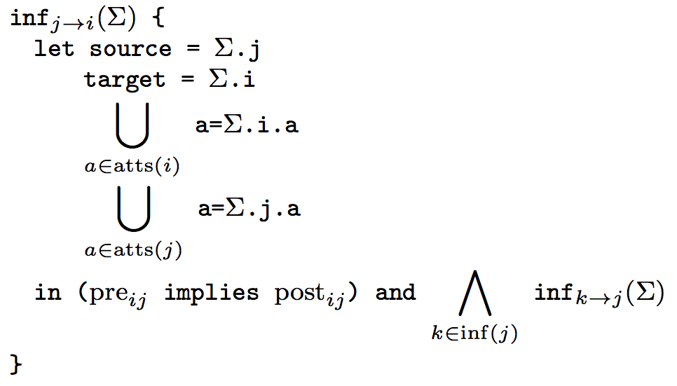
Mapping to Code(2)

Slide 30
Implementation Language
Theory
Mapping
Model
Influencer
Theory
Implementation
Theory

Slide 31
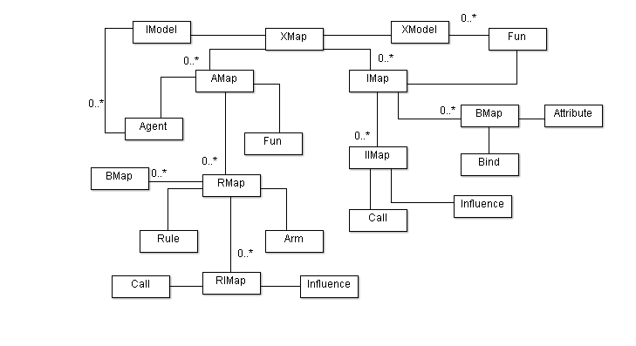
Model the Theory Mapping

Slide 32
Combinations of Theory Views
Consider a Library that allows readers to register, books to be borrowed and fines to be paid.
There are several views: temporal, registration, borrowing, payment.
Each view is a separate theory in terms of a different view.
What is the complete theory?

Slide 33
Complete
Theory
Register
Theory
Repay
Theory
Borrow
Theory
Time
Theory
WFF
Theory

Slide 34
Conclusion
Understanding is theory building.
Modelling and programming are essentially the same.
Modelling aims to be initial.
Programming needs to be terminal.
Modelling languages should support theories.
Theories need to support:
translation through mappings.
different views through combination.
patterns through parameterization.

