Slide 1
Model Based Functional Testing using Pattern Directed Filmstrips
Tony Clark
Centre for Model Driven Software Engineering
Thames Valley University
tony.clark@tvu.ac.uk

Slide 2
Overview
Industry likes using models.
Tests as part of requirements is a good idea.
Industry does not like scary stuff.
Can modelling:
Incorporate testing.
Make tests more diagrammatic.
Be more exemplar-based.
Do more stuff with use cases.

Slide 3
Example Model

Slide 4
Behaviour

Slide 5
Testing Behaviour – Wood from Trees
class TestSalesSystem extends TestCase {
private s = new SalesSystem();
public void testAddContact() {
String name = “fred jones”;
s.contact(name);
boolean added = false;
for(Person p : s.contactsDB().getPeople())
if(p.getCID().equals(name))
added = true;
AssertTrue(name + “ not added”,added);
}
...
}

Slide 6
Testing Behaviour – Scary!
context SalesSystem::contact(name:String)
pre:
not contactsDB.people->exists(p | p.name = name)
post:
contactsDB.people->exists(p | p.name = name)

Slide 7
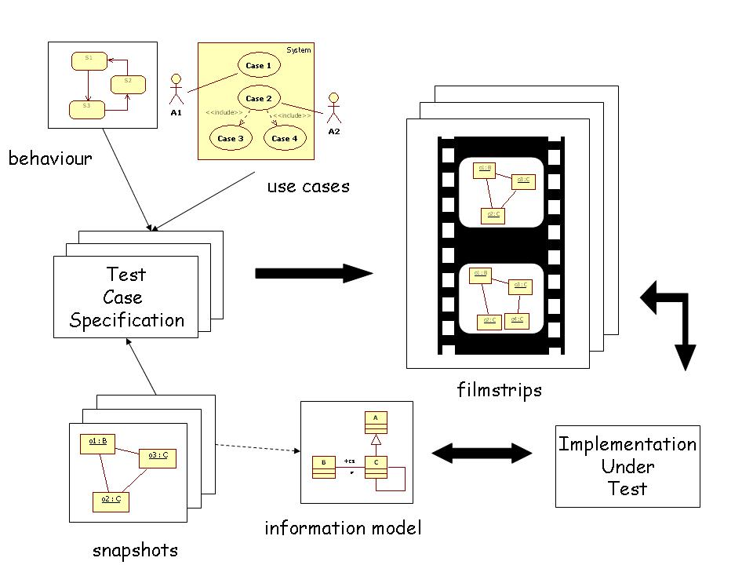
Model Driven Testing

Slide 8
Filmstrip Specification

Slide 9
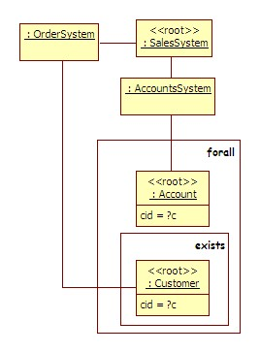
Snapshots: AccountsHaveCustomers
snapshot AccountsHaveCustomers { object:SalesSystem { accounts = object:AccountsSystem { accounts forall { root object:Account { cid = ?c object ?o:Customer {
cid = ?c } }
}
orderSystem = object:OrderSystem { customers exists { root?o:Customer { } object } } }

Slide 10
Language – Text matches Graphics
F ::= let V = S in F local defs | always S { F } invariants | F F sequences | F* repetition | step Op pre S post S steps
Op ::= V(E*) operations
S ::= S and S logical and | S or S logical or | not S logical not | S[V/V] renaming | snapshot B snapshots
B ::= { ([root]O)* } object sets
O ::= object [V]:T { (Q|F)* } objects
Q ::= V (forall | exists) B quantification
F ::= V (= | <>) E slots
E ::= V | Int | Str | Bool | O values

Slide 11
Example
let AccountsHaveCustomers = ... UniqueIds = ...
in always AccountsHaveCustomers and UniqueIds {
(step contact(?id:String) pre snapshot { root object:SalesSystem { contactsDB = object:ContactsDB { people forall { root object:Person { cid <> ?id } } } }
post snapshot { root object:SalesSystem { contactsDB = object:ContactsDB {
people exists { root object:Person { cid = ?id } } } } ... ship, register and placeOrder)* }

Slide 12
Demonstration
DSL for testing in XMF
Run against SalesSystem in Java
Caveats:
Filmstrip language
OCL for snapshots (not this demo)
No implementation mapping.

Slide 13
Conclusion
Extend UML for model based testing:
Filmstrips (based on use cases)
Snapshot patterns (based on object models)
Semantics: sequences of object models.
Testing:
Generate candidate filmstrips
Run against SUT (after implementation mapping)

