Slide 1
Model Driven Development:
What went right?
What went wrong?
What needs to happen?
Tony Clark
Middlesex University
London, UK
t.n.clark@mdx.ac.uk
http://www.eis.mdx.ac.uk/staffpages/tonyclark/

Slide 2
Overview
The problems with Modelling….
What is MDD?
What did MDD promise?
An idealized model based industry.
How did we get here?
An attempt.
Are we there yet?

Slide 3
What is Modelling?
Contrast Programming and Specification.
Modelling lies in-between.
How do people do it?
Leads us to some requirements…

Slide 4
System Building: Endogeneous Descriptions
Start with nothing:
Add extra information
incrementally:
It does what it does
and nothing more:
If it is wrong, modify it:

Slide 5
System Specification:
Exogeneous Descriptions
Start off with everything:
Add constraints:
It does anything
but must include
required behaviour:

Slide 6
The Exo-Endo Divide
A problem with specification/modelling technologies.
It is easy to under specify or over specify.
It is difficult to check
exo-endo match.

Slide 7
Model Driven Exo-Endo Problems
Cannot execute the models.
Cannot generate code from the models.
Ambiguous models lead to wrong choices.
Example: models are just code-in-pictures.
Example: models are just diagrams.

Slide 8

Peter Naur and Theory Building
Systems are more than just code.
Developers should understand
systems in terms of theories.
A theory contains facts about
the system.
Theories are personal.
Theories are built by
interacting with the
‘real world’.
Theory

Slide 9
Domain Specific
Theories
Domain
Theory
Multiple theories at work.
A theory of the problem domain.
A theory of the solution domain.
A mapping between them.
Implementation
Theory

Slide 10
Theory Encoding leads to a Problem
Theory
Theories must be encoded in technology.
Bound to be incomplete.
Using domain specific technologies will help.

Slide 11
Domain Specific vs General Purpose
Domain
Specific
Models and implementation
languages reduce the theory
mismatch.
Try to be as domain specific
as possible.
This introduces the need for
a transformation to
implementation technology.
Implementation
Specific

Slide 12
A Whole Space of Problems
Domain
Theory
Domain
Specific
Implementation
Specific
Implementation
Theory

Slide 13
A Technology Space
Domain
Specific
IDEAL
DSLs
UML+Profiles
Lisp
UML
FP
Formal Methods
Java
Theory
Completion

Slide 14
Requirements on MD Technologies
Theory Building.
Domain Specific Representations.
Fill the gap.
Ease of transition Problem to Solution.

Slide 15
What is MDD?
Using models in the development process.
Trying to close the gaps identified above.
Essentially two main approaches:
  MDA, code generation.
  Run-time models.

Slide 16
Promises, Promises, ...
Faster development time.
Technology independence.
Agility.
Better quality products and processes.
Ease of maintenance.
Domain expert involvement.
Cost reduction.
Automated Testing.

Slide 17
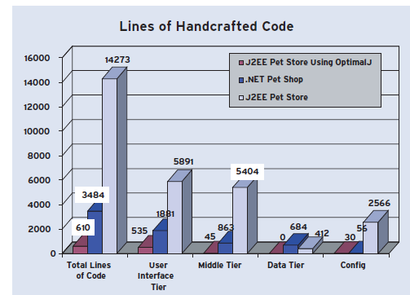
The Promise of MDA
(or how it was sold to us)
OMG Position Paper (2003): Driving business agility with Model Driven Architecture
http://www.omg.org/mda/mda_files/3302_AccelDev_PP.pdf

Slide 18
Model Driven Nirvana
If only we could do:
Enterprise Architecture
Executable Modelling.
Theory Building.
Design languages for each domain.
Round trip.
Reusability.
Views.
Queries.
Interoperability.

Slide 19
The Ideal Model Driven Enterprise
Aspects of Enterprise Architecture.
Use-Cases for the Model Driven Enterprise.
The Business Context.
The Business Drivers.
Refinement.
Capability Requirements.
Technology Requirements.

Slide 20
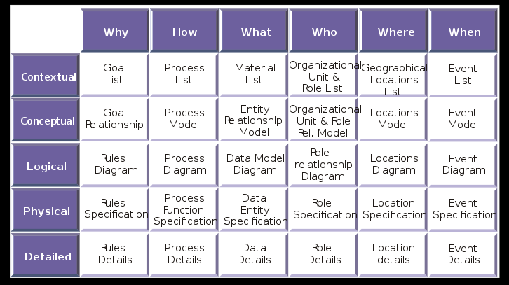
Zachman Framework

Slide 21
Use Cases for the Model Driven Enterprise
Effective Business Execution.
Agility.
Business Change Management.
Acquisition and Mergers.
Quality Management.
Resource Management.
IT System Generation

Slide 22
The Business Context
Regulations
Business
Events
Biz Context
Application
Directives
Technology

Slide 23
The Business Drivers
Information
Resources
Structure
Goal
Model
Model
Policies
Regulations
Business
Events
Biz Context
Application
Directives
Technology

Slide 24
Refinement
Information
Resources
Structure
Goal
Model
Model
Policies
Regulations
Business
Goal
Goal
Events
Model
Model
Model
Model
Biz Context
Application
Directives
Technology

Slide 25
Capability Requirements
Information
Resources
Structure
Goal
Model
Model
Policies
Regulations
Business
Goal
Goal
Events
Model
Model
Model
Model
Biz Context
Application
Directives
Technology

Slide 26
Technology Requirements
Information
Resources
Structure
Goal
Model
Model
Policies
Regulations
Business
Goal
Goal
Events
Model
Model
Model
Model
Biz Context
Application
Directives
Technology

Slide 27
Business Intelligence
Information
Resources
Structure
Goal
Model
Model
Policies
Regulations
Business
Goal
Goal
Events
Model
Model
Model
Model
Biz Context
Application
Directives
Technology

Slide 28
Requirements on MD Technologies
Integrated Business to Technology stack.
BI (reverse engineered dynamic data).
Event-driven, reactive.
Adaptive.
All-code or No-code?
Dynamic update.

Slide 29
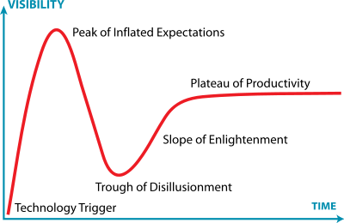
Where are we?
Gartner Hype Cycle: http://en.wikipedia.org/wiki/Hype_cycle

Slide 30
UML: The Dominant Technology
Relatively Mature.
Hundreds of tools, many free.
Interoperable (?).
Taught in Universities.
Basis for MDA.
Profiles.

Slide 31
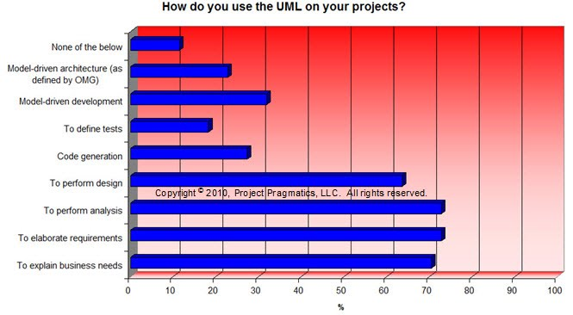
How is UML Used?
Bob Maksimchuk, Principal Consultant, Project Pragmatics, Rmaksimchuk@ProjectPragmatics.com

Slide 32
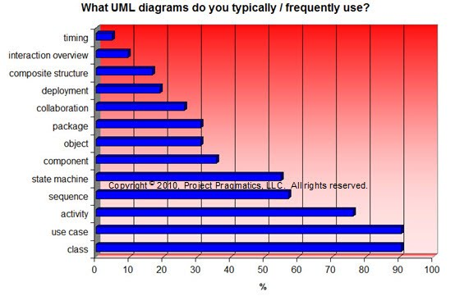
Which Parts of UML?
Bob Maksimchuk, Principal Consultant, Project Pragmatics, Rmaksimchuk@ProjectPragmatics.com

Slide 33
Other Technologies
System modelling: SysML, MODAF, TOGAF, ArchiMate, etc.
Transformations: QVT, ATL, Kermeta, etc.
Domain Specific Modeling Tools: MetaEdit+, Eclipse Modeling Project, XMF-Mosaic, etc.
Language-Oriented Programming: projectional languages, Xtext; Spoofax; XMF.

Slide 34
How did we get here?
[- 1980s] Programming languages.
[1980s] CASE Tools.
[1980s] OO Languages.
[1985-1995] OO Methods.
[1995-] OO Standards.
[2000-] Model Driven Architecture.
[2002-] Model Transformations.
[2003-] Meta-Technologies.
[2005-] Software Language Engineering.
[2005-] Scripting Languages.

Slide 35
Xactium: Personal Experience
XMF: The Ideal Endogenous Modelling Platform?
XMF-Mosaic: The Ideal Exogenous Modelling Platform?
Closing the Endo-Exo Divide?
Technology grew out of UML 2.0 work.
Language-Oriented Modelling Approach: Lifting the domain-specific abstraction.

Slide 36
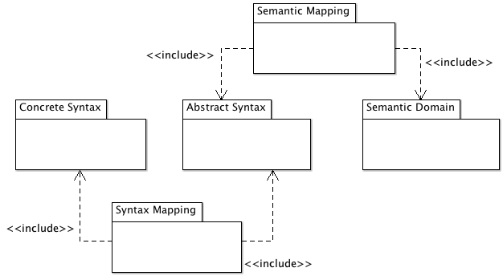
Language-Oriented Modelling

Slide 37
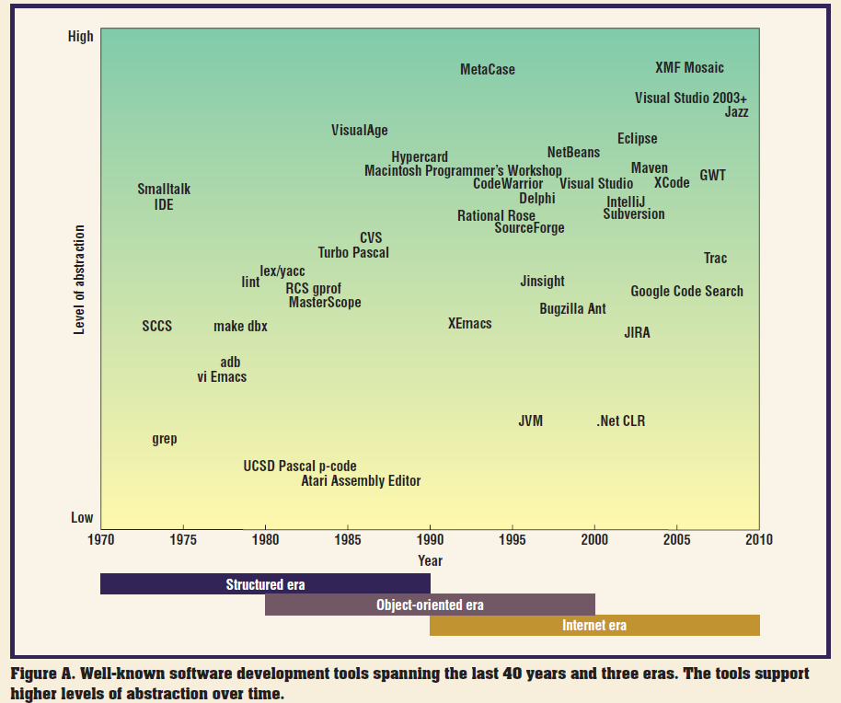
Where’s My Jetpack? Simon Helsen, Arthur Ryman, Diomidis Spinellis, IEEE Software, Special Issue Software Development Tools 2008

Slide 38
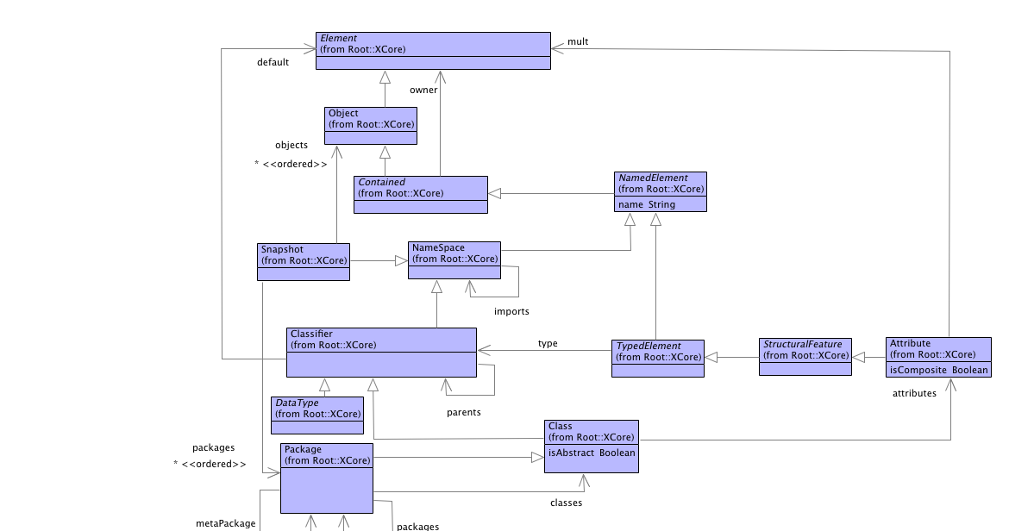
Xcore Meta-Structure

Slide 39
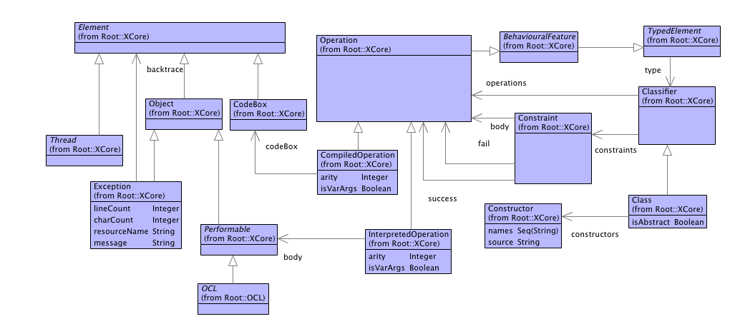
Xcore Meta-Behaviour

Slide 40
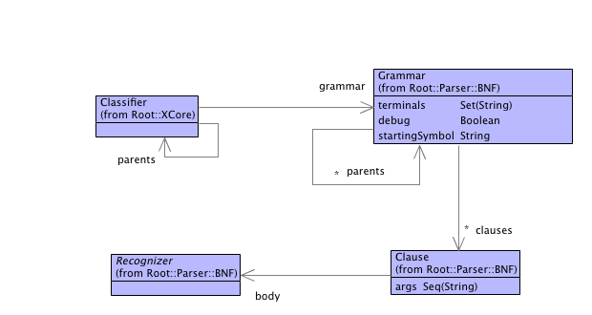
XMF Textual DSLs

Slide 41
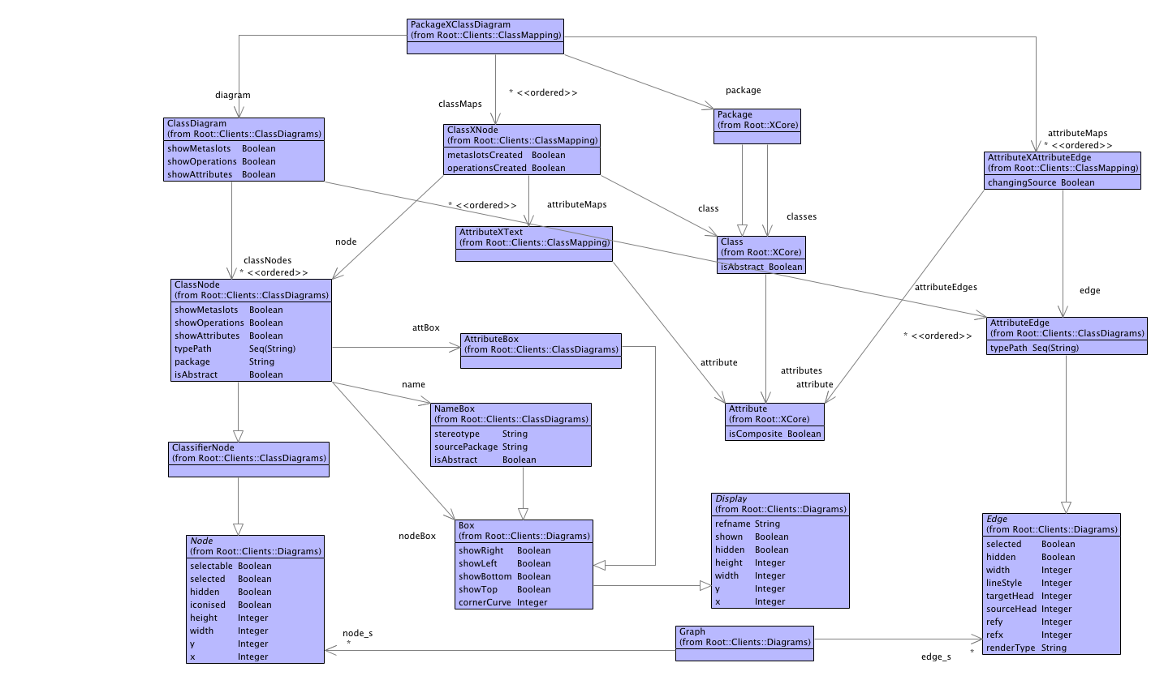
XMF-Mosaic Graphical DSLs

Slide 42
XMF-Mosaic
A demo.

Slide 43
Are we there yet?
Requirements:
Theories: richer languages.
Domain Specific: match the problem domain.
Execution: program with models at all levels.
Reflection: self aware tools.
Meta: arbitrary extension.
Semantics: meaningful technologies.

